Slide 1
从感知智能到认知智能
Jie Tang
Computer Science
Tsinghua University
  The slides can be downloaded at http://keg.cs.tsinghua.edu.cn/jietang

Slide 2
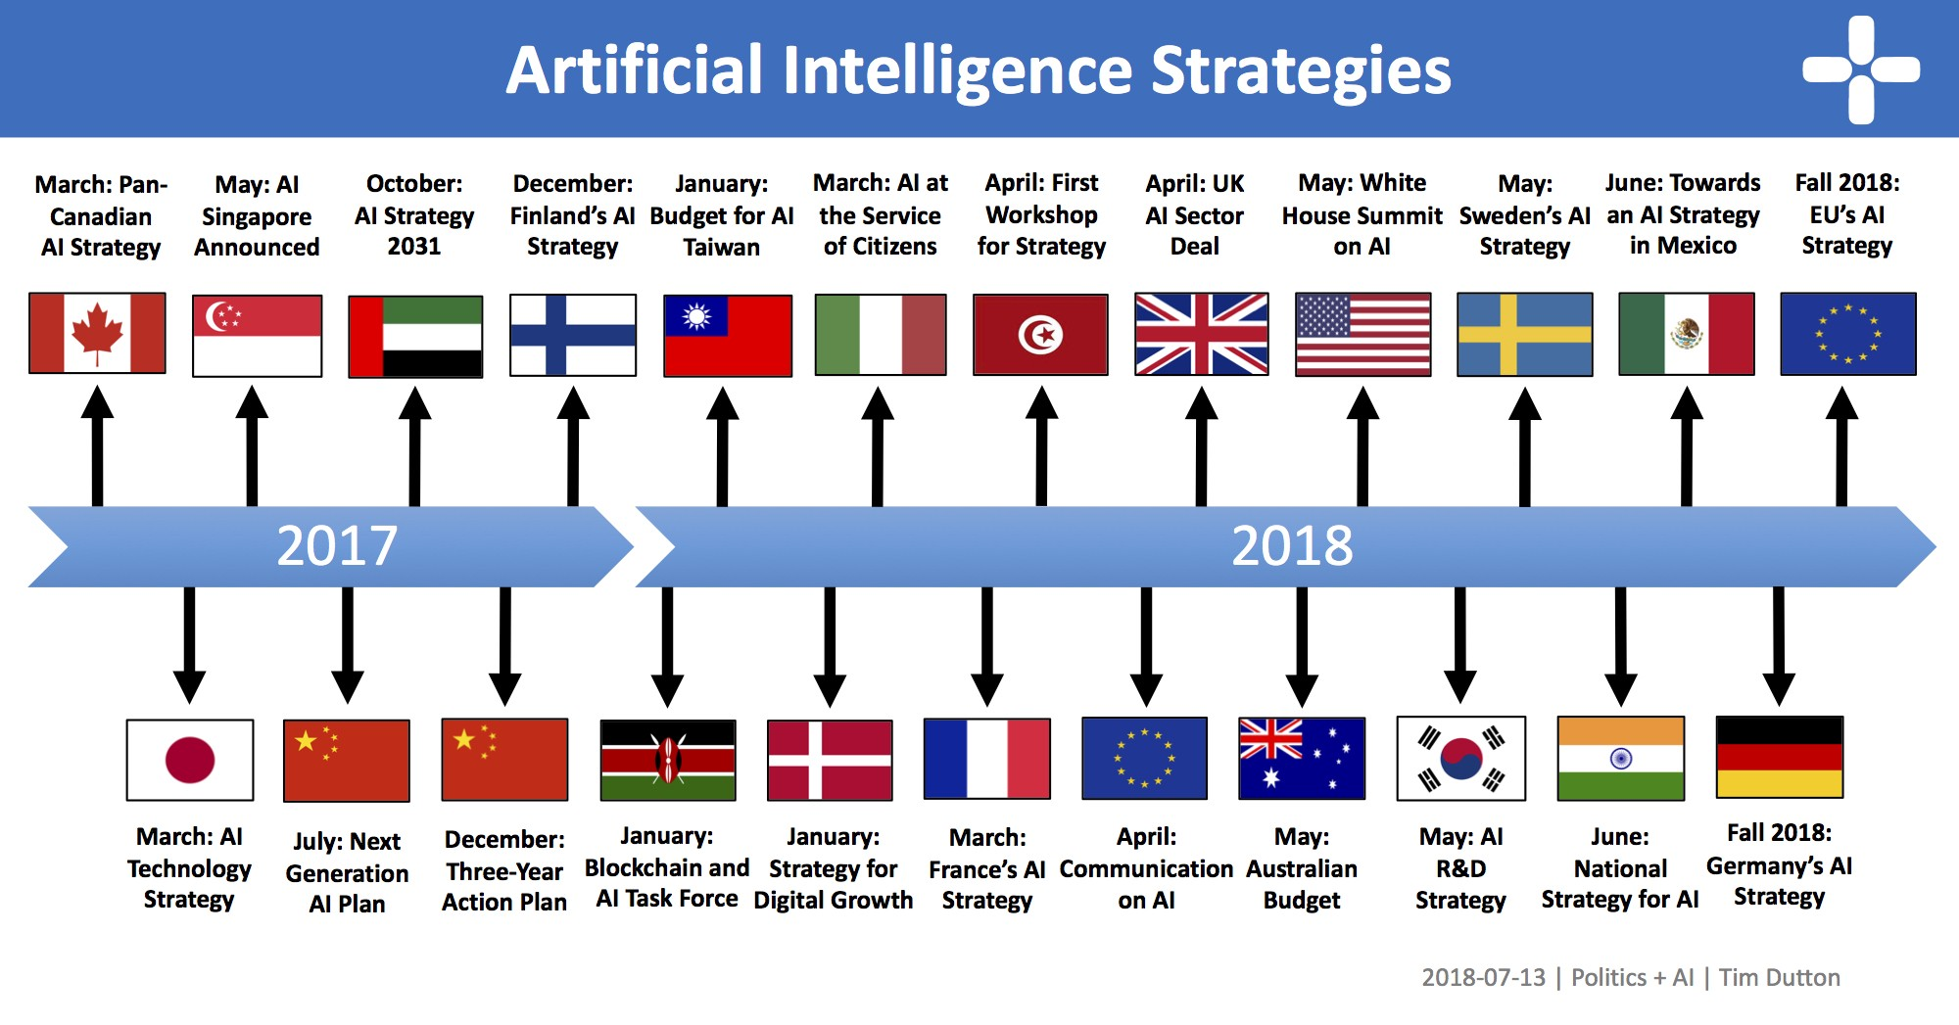
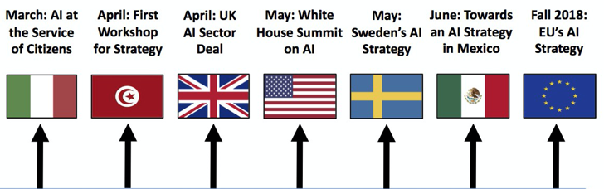
人工智能的第三次浪潮

Slide 3
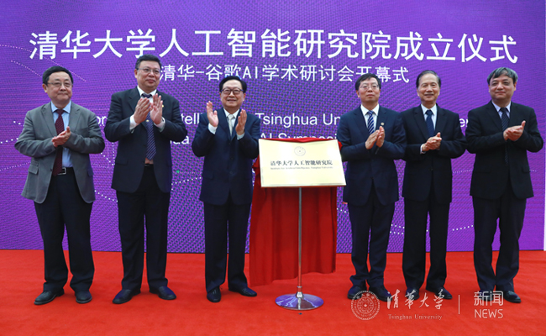
我校在人工智能方面的先发优势
我校是国内最早开展人工智能研究的单位之一
“智能技术与系统国家重点实验室”是第一个冠名以“智能”的国家重点实验室
我校人工智能方向2019年在CS Ranking中排名世界第一

Slide 4
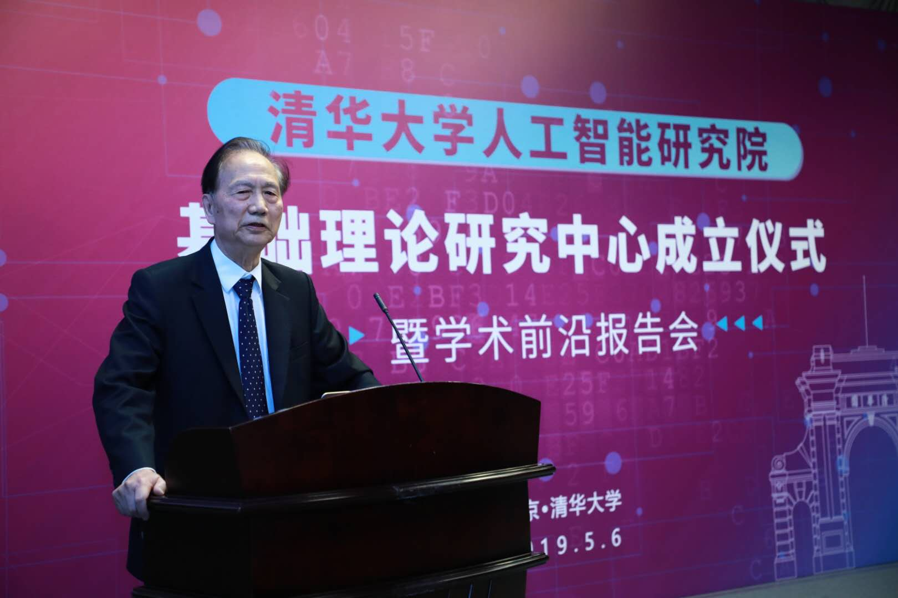
第三代人工智能的理论体系
早在2015年，张钹老师就提出第三代人工智能体系的雏形；2017年DARPA发起XAI项目，从可解释的机器学习系统、人机交互技术以及可解释的心理学理论三个方面，全面开展可解释性AI系统的研究
2018年底，正式公开提出第三代人工智能的理论框架体系
  建立可解释、鲁棒性的人工智能理论和方法
  发展安全、可靠、可信及可扩展的人工智能技术
  推动人工智能创新应用
具体实施路线图
  与脑科学融合，发展脑启发的人工智能理论
  数据与知识融合的人工智能理论与方法
第三代人工智能的理念在国内外获得广泛影响力
  国内：牵头军事智能基础理论战略先导论证，
  参与军事智能理论发展规划
  国际：与哈佛大学、东京大学、德国波恩大学、
  以色列理工等学校开展合作

Slide 5
回顾中心成立…

Slide 6
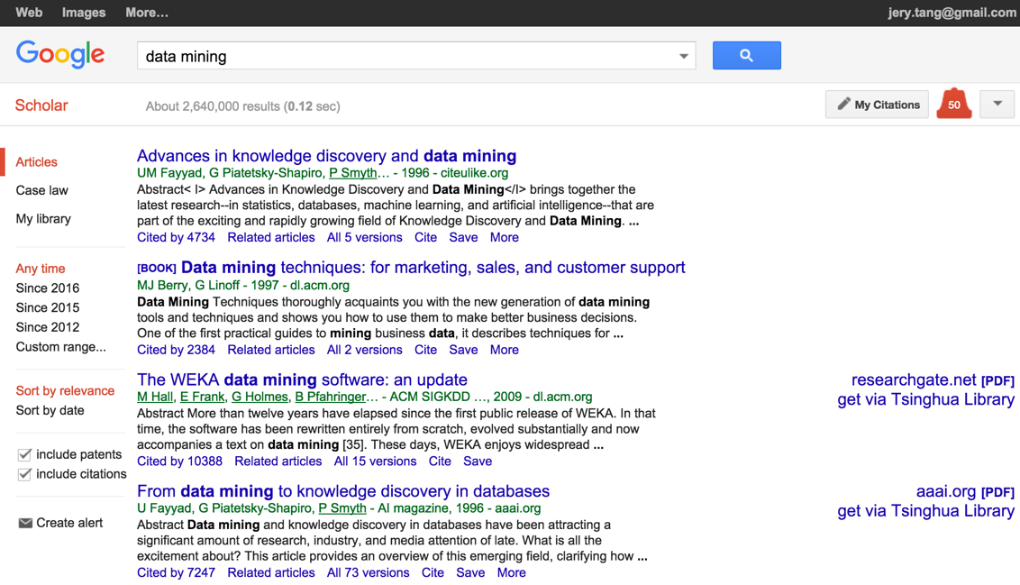
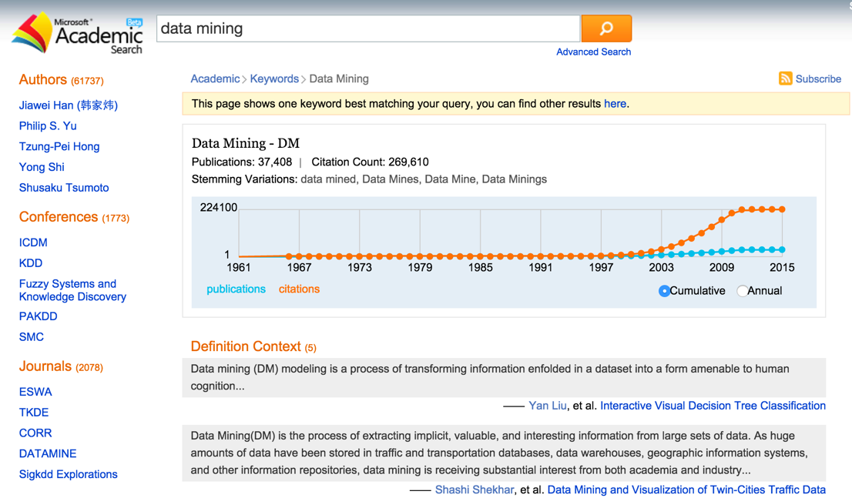
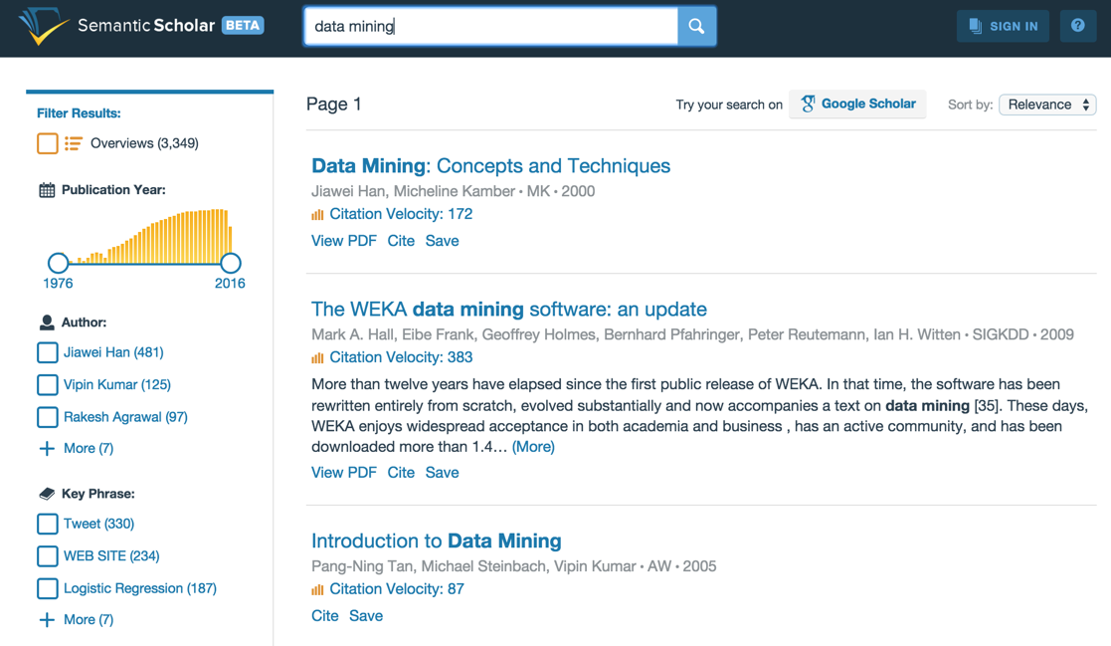
科技情报分析
公司 | 系统名称 | 发布时间 | 特性描述
谷歌 | Google Scholar | 2004 | 大规模学术论文检索、学术主页
微软 | Academic Search | 2014 | 学术搜索、学者搜索
汤森路透 | Web of Science | 2008 | 科学引用指标、交叉学科引用指标
爱思唯尔 | Scopus | 2004 | 全学科、交叉学科文献收集
自然 | Digital Science | 2010 | 学者画像、评阅人推荐
清华 | AMiner | 2006 | 知识驱动的智能情报分析
Notes:
P5: 美国、欧洲和日本等国均制定科技情报挖掘与智能服务的战略发展计划。
Science of Science & Innovation Policy:
http://www.nsf.gov/pubs/2008/nsf08586/nsf08586.htm
Open science & research innovation
http://www.kowi.de/Portaldata/2/Resources/fp/Open-Innovation-Open-Science-Open-to-the-World.pdf
http://www.nsf.gov/funding/pgm_summ.jsp?pims_id=501084
http://www.nsf.gov/awardsearch/advancedSearchResult?WT.si_n=ClickedAbstractsRecentAwards&WT.si_x=1&WT.si_cs=1&WT.z_pims_id=501084&ProgEleCode=7626&BooleanElement=Any&BooleanRef=Any&ActiveAwards=true&#results
$30264691
http://cordis.europa.eu/project/rcn/104130_en.html
Funded under: FP7-INFRASTRUCTURES
Helix Nebula - The Science Cloud
EUR 2 726 627
https://danube-inco.net/object/call/16512
EUROPEAN OPEN SCIENCE CLOUD FOR RESEARCH (H2020)
EUR 5 and 10 million
日本科学技术振兴会
http://www.bsc.cas.cn/jlyd/ywyj/201602/P020160202540202619158.pdf
http://www.greynet.org/images/GL7,_page_77.pdf
For J-STAGE(Japan Science and Technology Information Aggregator, Electronic), JST gets the Japanese government budget about 1.2 billion Japanese Yen for each fiscal year. The total costs (including the systems development, maintenance, and operational costs) since 1998 is about 9.5 billion Japanese Yen.

Slide 7
新挑战
1
知识以碎片化的形式分散在异构、多源数据中，自动知识获取难度大；
美国NSF和Army(仅2015年就超过8千万美元)- Science of Science
欧盟第8框架H2020(6项关于科技情报分析,共21项学科领域项目)
2
知识网络结构复杂、交互行为动态多样，挖掘隐含关联关系十分困难；
今年截止目前为止的Nature和Science杂志中已有23篇关于科技大数据挖掘的论文
3
知识网络规模大、噪音大、高度动态，匹配效率低是智能型知识计算的瓶颈。
多个顶尖学术研究机构(MIT,哈佛,康奈尔,芝加哥等)建立相关团队

Slide 8
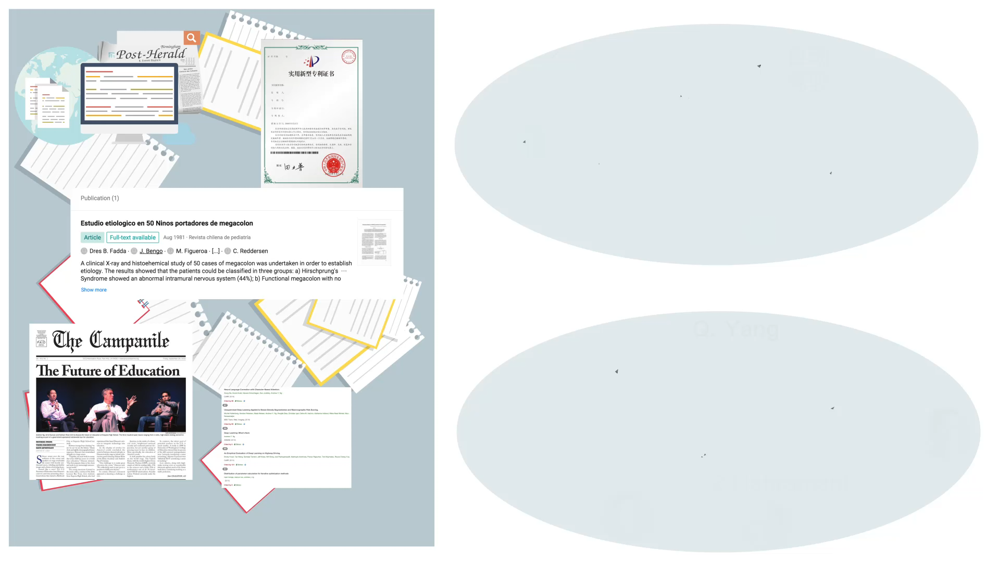
AMiner.cn: 深度科技情报分析
知识获取
科技知识图谱构建
知识获取
科技知识图谱构建
隐含关联
知识到隐含推理
语义匹配
知识到智能服务
关联挖掘
隐含关联
知识到情报挖掘
快速算法
语义匹配
情报到智能服务

Slide 9
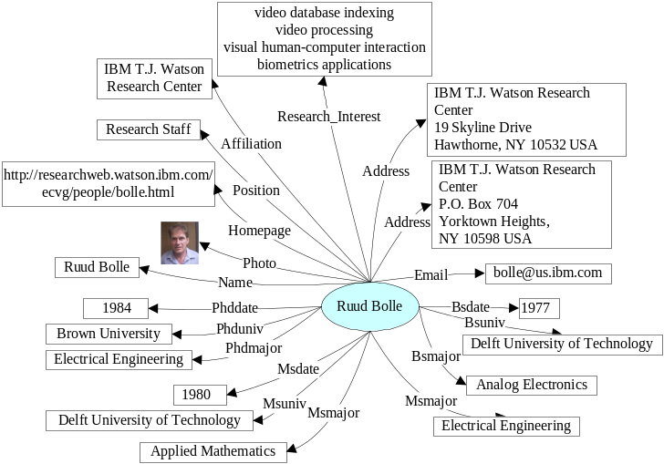
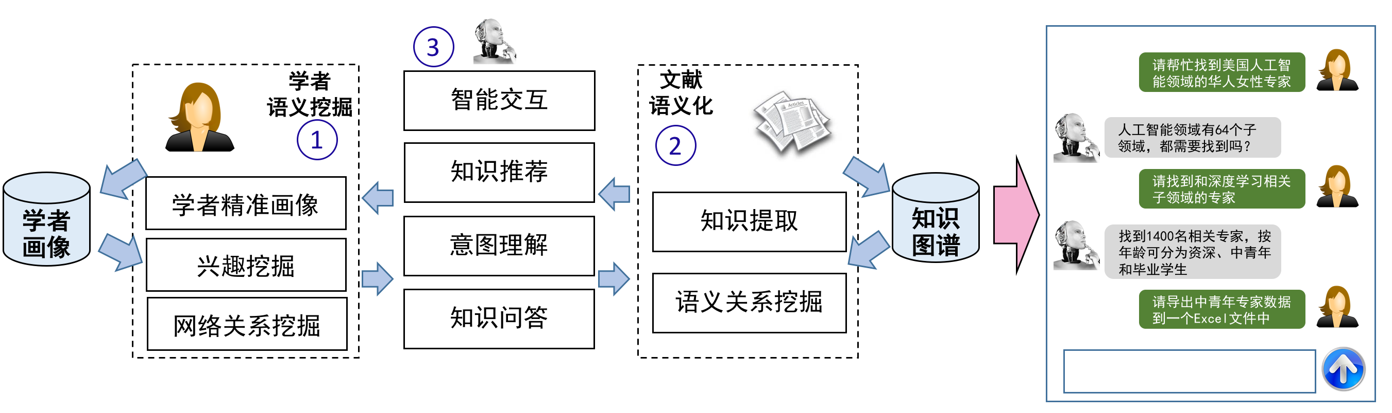
深度洞察—以AI为例
人工智能
artificial intelligence
人工智能
data mining
知识图谱
machine learning
数据挖掘
机器学习
data clustering
association rule
关联规则
聚类
人才画像
智能交互

Slide 10
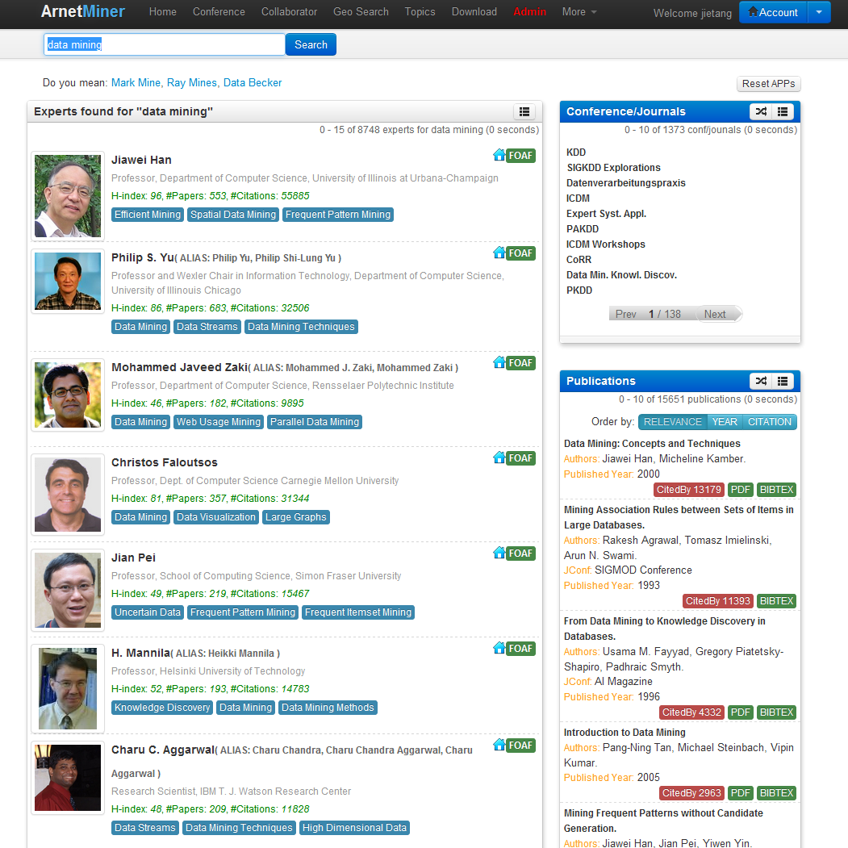
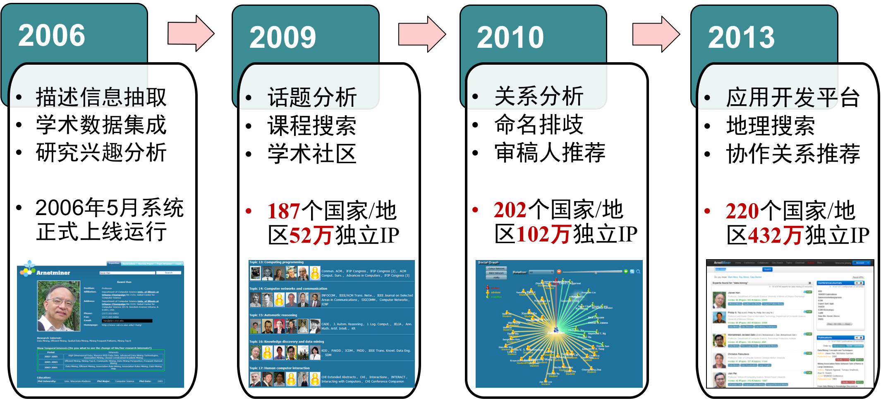
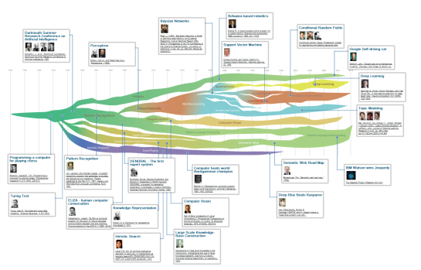
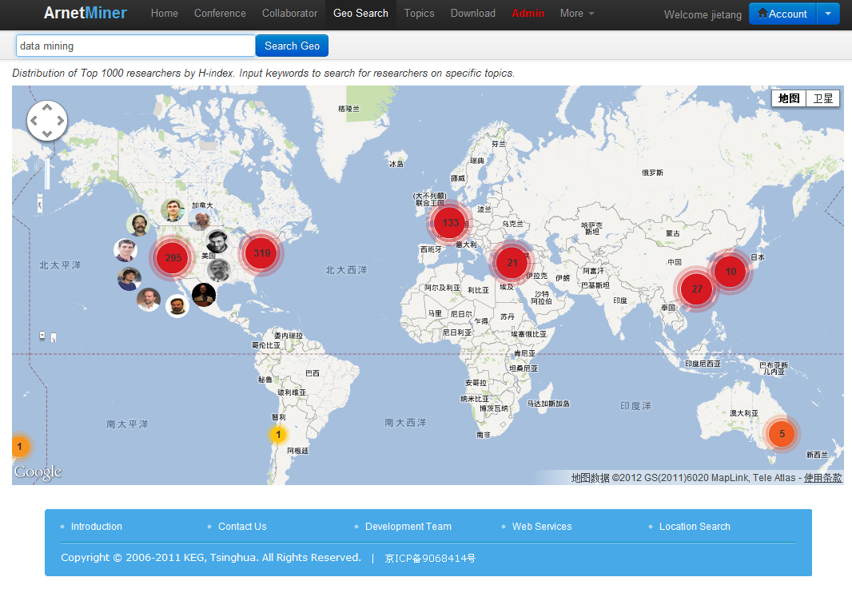
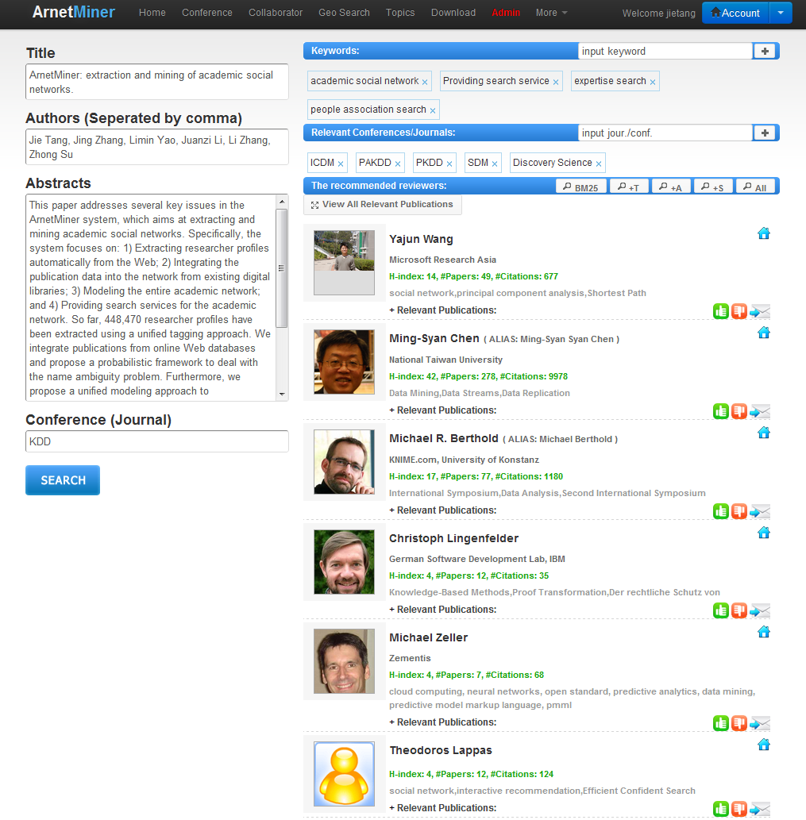
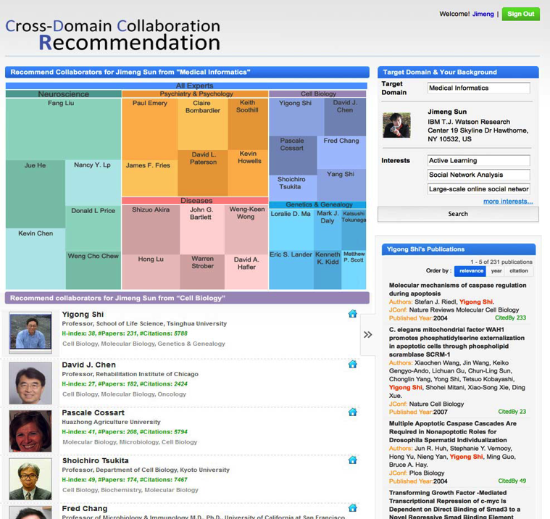
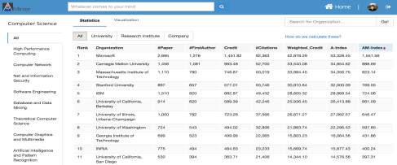
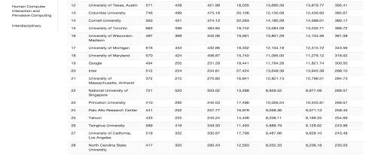
AMiner—知识驱动的科技大数据挖掘平台
研发了知识驱动的科技情报挖掘平台AMiner，建立超过3亿篇学术论文/专利和1.36亿科研人员的科技智库
专家发现
平台研发历程
科技趋势分析
人才地图
智能指派
合作者推荐
机构评估
Notes:
P29: 平台提供多种科技情报服务，包括：专家发现、评阅人推荐、合作者推荐、机构分析、竞争力关系、地域分析以及科技趋势分析等功能，吸引了全球220个国家和地区700多万独立IP访问。

Slide 11
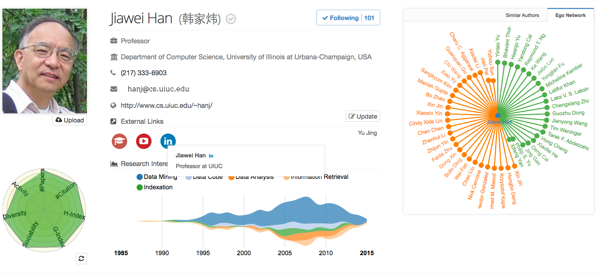
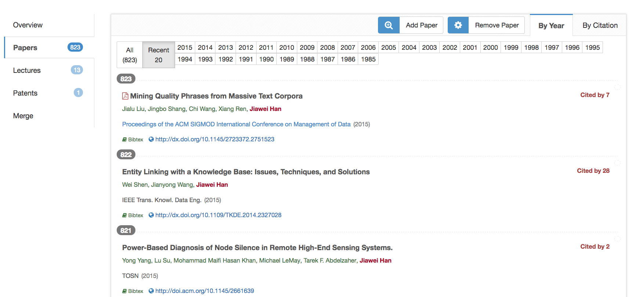
系统平台基础
科技情报挖掘及智能服务AMiner.cn
  2006年开始运行
  论文>3.0亿，引用关系 >7.5亿
  学者>1.3亿
  知识概念>800万概念
  论文日更新>5万
  全球1000多万独立IP访问
获得2013中国人工智能学会科技进步一等奖，2017北京市科技进步一等奖
论文来源 | 数量
MAG | 1.8亿
CKCEST | 2.0亿
pubmed | 3000万
EI | 700万
DBLP | 460万
Springer, Scopus, ACM, IEEE等 | 1100万
实时抓取 nature等400+期刊 | 1500万
去重总数 | 3.0亿
Notes:
P10：截止目前，平台已经采集了1.36亿科研人员信息和2.28亿论文数据

Slide 12
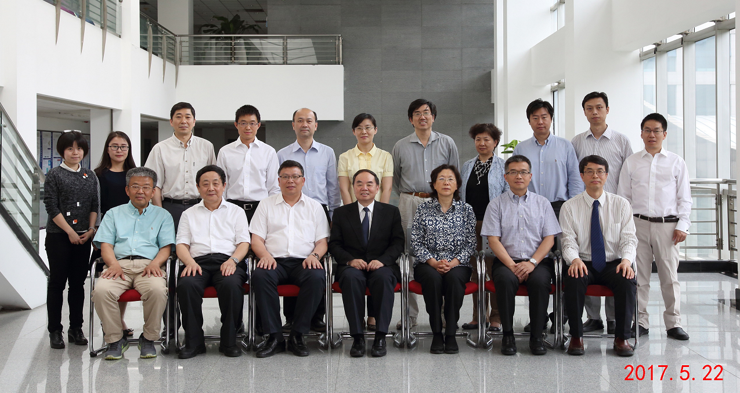
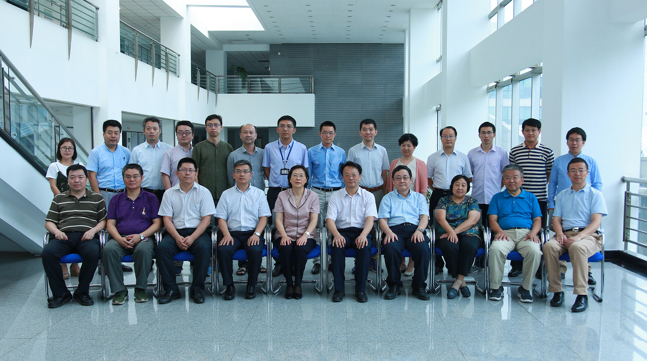
清华-工程院知识智能联合研究中心
2017
2018

Slide 13
认知图谱 (Cognitive Graph)
—知识图谱, 认知推理, 逻辑生成
  The slides can be downloaded at http://keg.cs.tsinghua.edu.cn/jietang

Slide 14
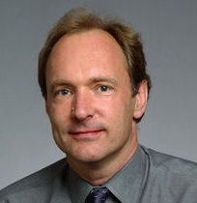
知识图谱
“Knowledge graph”由Google于2012年提出
知识工程，专家系统
CYC: 世界上历史最长的AI项目 (1985)
Edward Feigenbaum
Father of KB
Turing Award
Tim Berners Lee
Father of WWW
Turing Award

Slide 15
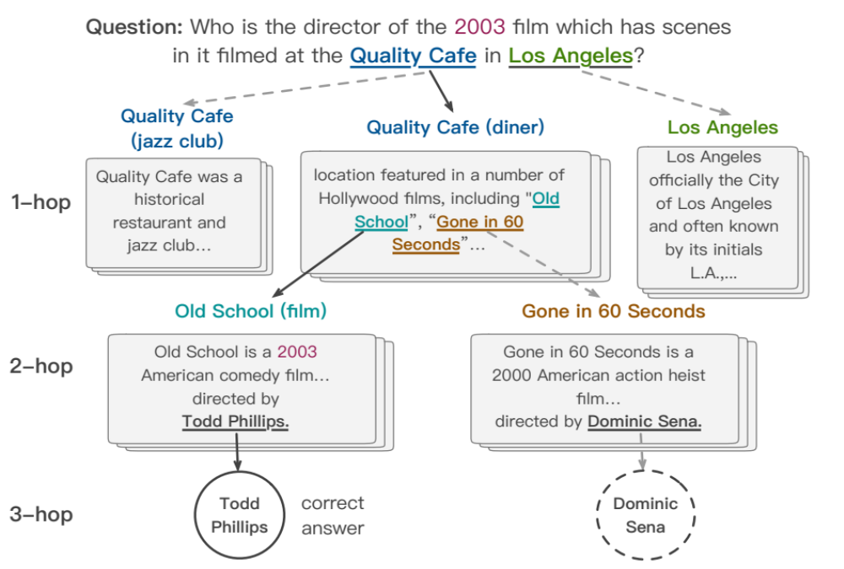

认知图谱：知识与认知的结合
Quality Café
Los Angeles
Alessandro Moschitti
The Quality Cafe is a now-defunct diner in Los Angeles, California. The restaurant has appeared as a location featured in a number of Hollywood films, including Old School, Gone in 60 Seconds, ...
Los Angeles is the most populous city in California, the second most populous city in the United States, after New York City, and the third most populous city in North America.
Alessandro Moschitti is a professor of the CS Department of the University of Trento, Italy. He is currently a Principal Research Scientist of the Qatar Computing Research Institute (QCRI)
Old School
Todd Phillips
Tsinghua University
Old School is a 2003 American comedy film released by Dream Works Pictures and The Montecito Picture Company and directed by Todd Phillips.
Todd Phillips is an American director, producer, screenwriter, and actor. He is best known for writing and directing films, including Road Trip (2000), Old School (2003), Starsky & Hutch (2004), and The Hangover Trilogy.
Tsinghua University is a major research university in Beijing and dedicated to academic excellence and global development. Tsinghua is perennially ranked as one of the top academic institutions in China, Asia, and worldwide...

Slide 16
挑战 1: 短视检索问题
Document A
Old School is a 2003 American comedy film released by DreamWorks Pictures and The Montecito Picture Company…
Document B
Many directors shoot scenes in Hollywood, Los Angeles, which is notable as the home of the U.S. film industry.
对于多跳问答的问题，问题和答案间拥有多少相似词汇已经不能作为答案检索的重要依据。

Slide 17
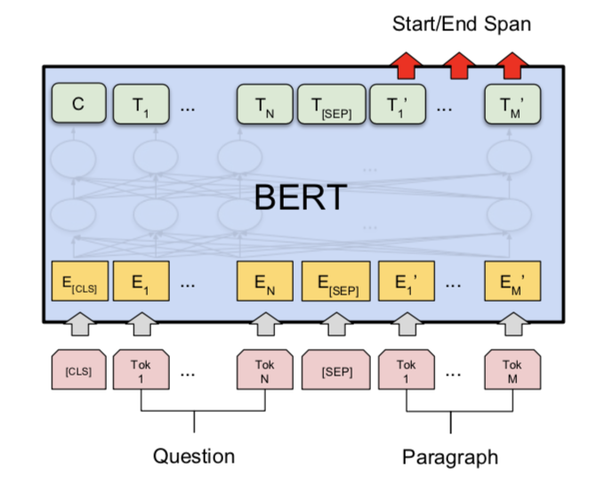
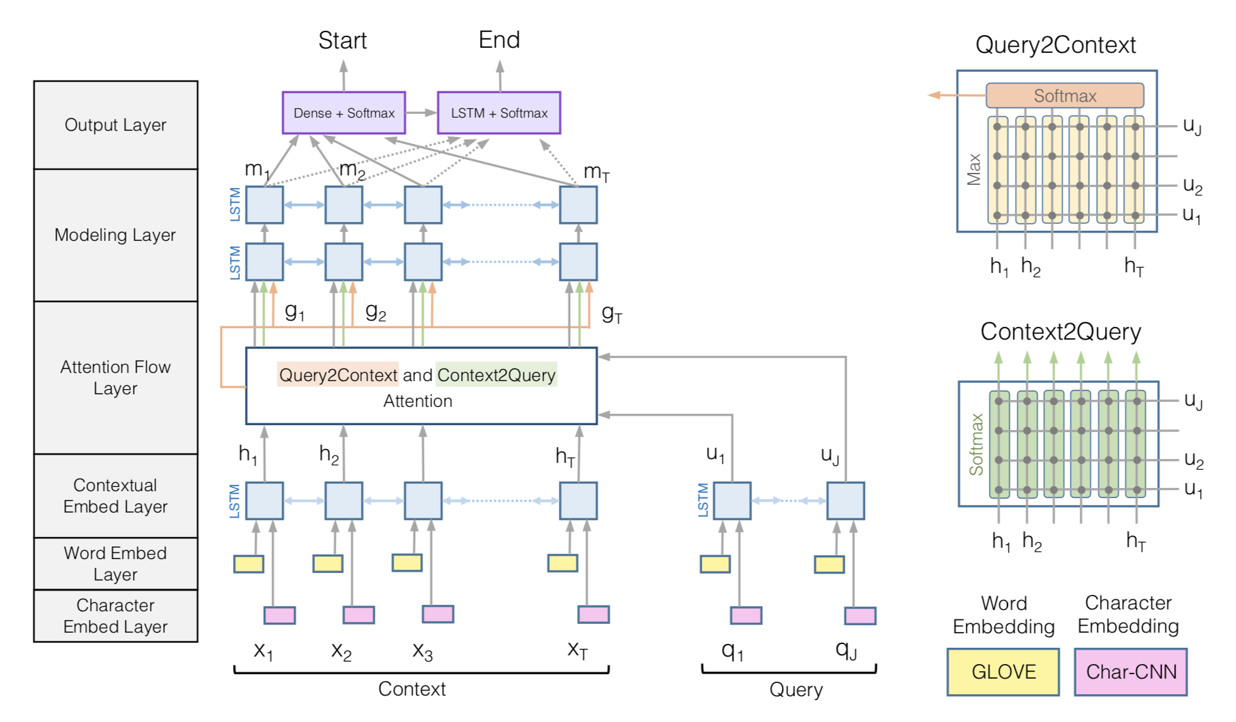
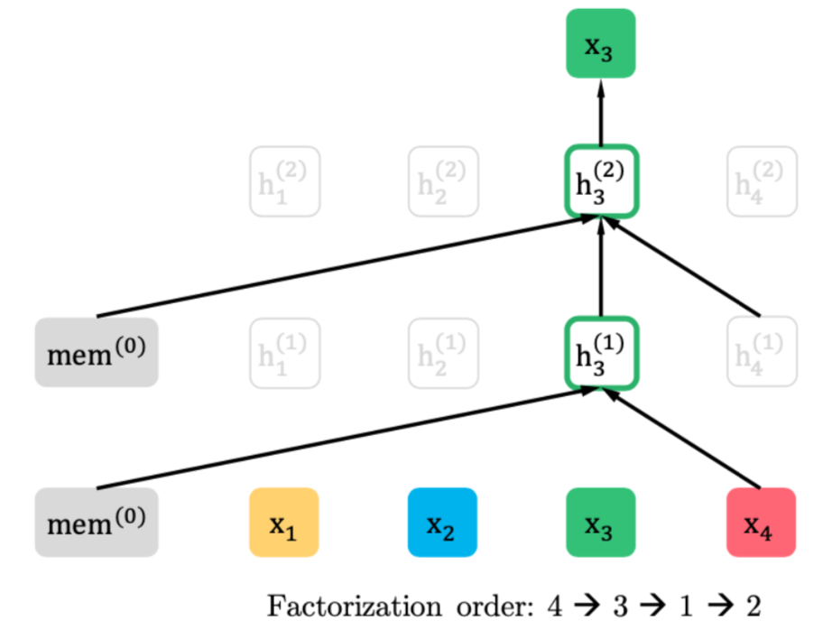
最新的进展: BIDAF, BERT, XLNet
目标：理解整个文档，而不仅仅是局部片段
但仍然缺乏在知识层面上的推理能力
BiDAF
BERT
XLNet

Slide 18
挑战 2: 可解释性
大部分阅读理解方法都只能看做黑盒:
  输入: 问题和文档
  输出: 答案文本块 (在文档中的起止位置)
如何让用户可以验证答案的对错:
  推理路径或者子图
  每个推理节点上的支撑事实
  用于对比的其他可能答案和推理路径

Slide 19
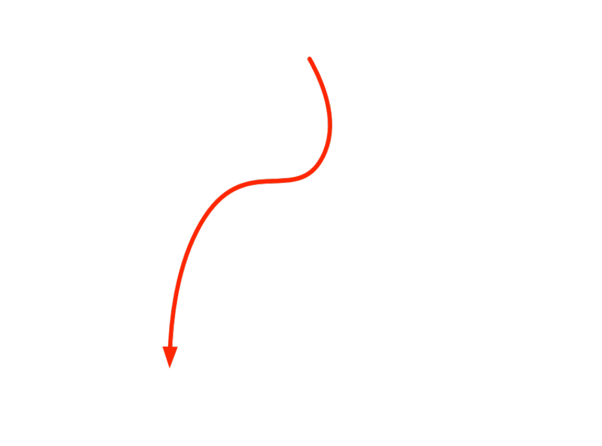
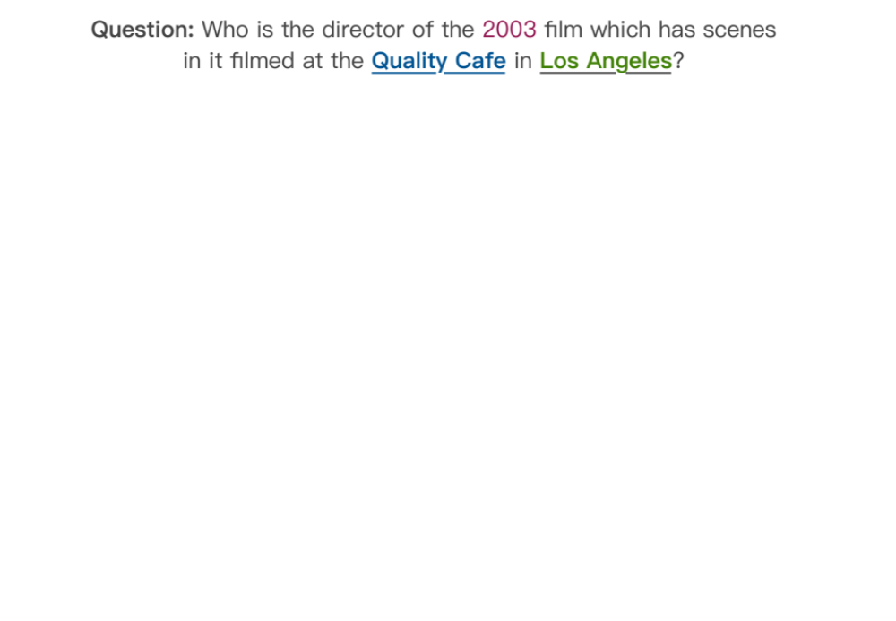
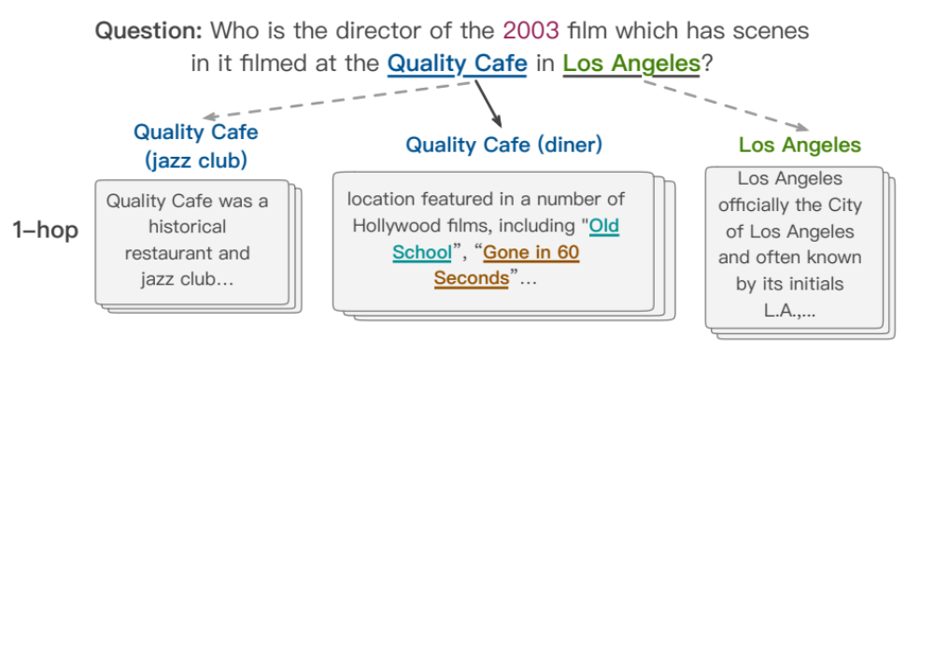
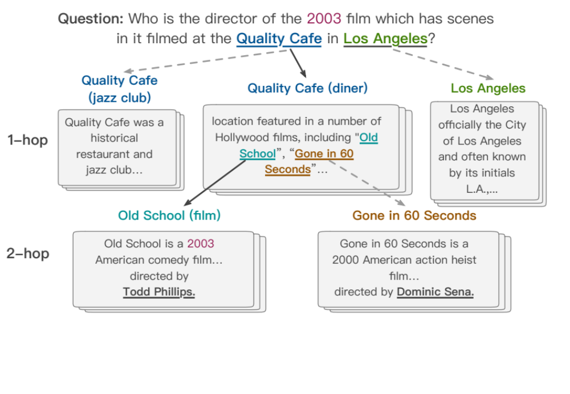

认知图谱: 知识表示, 推理和决策

Slide 20
和认知科学的结合
System 1
Intuitive
System 2
Analytic
Dual Process Theory (Cognitive Science)

Slide 21
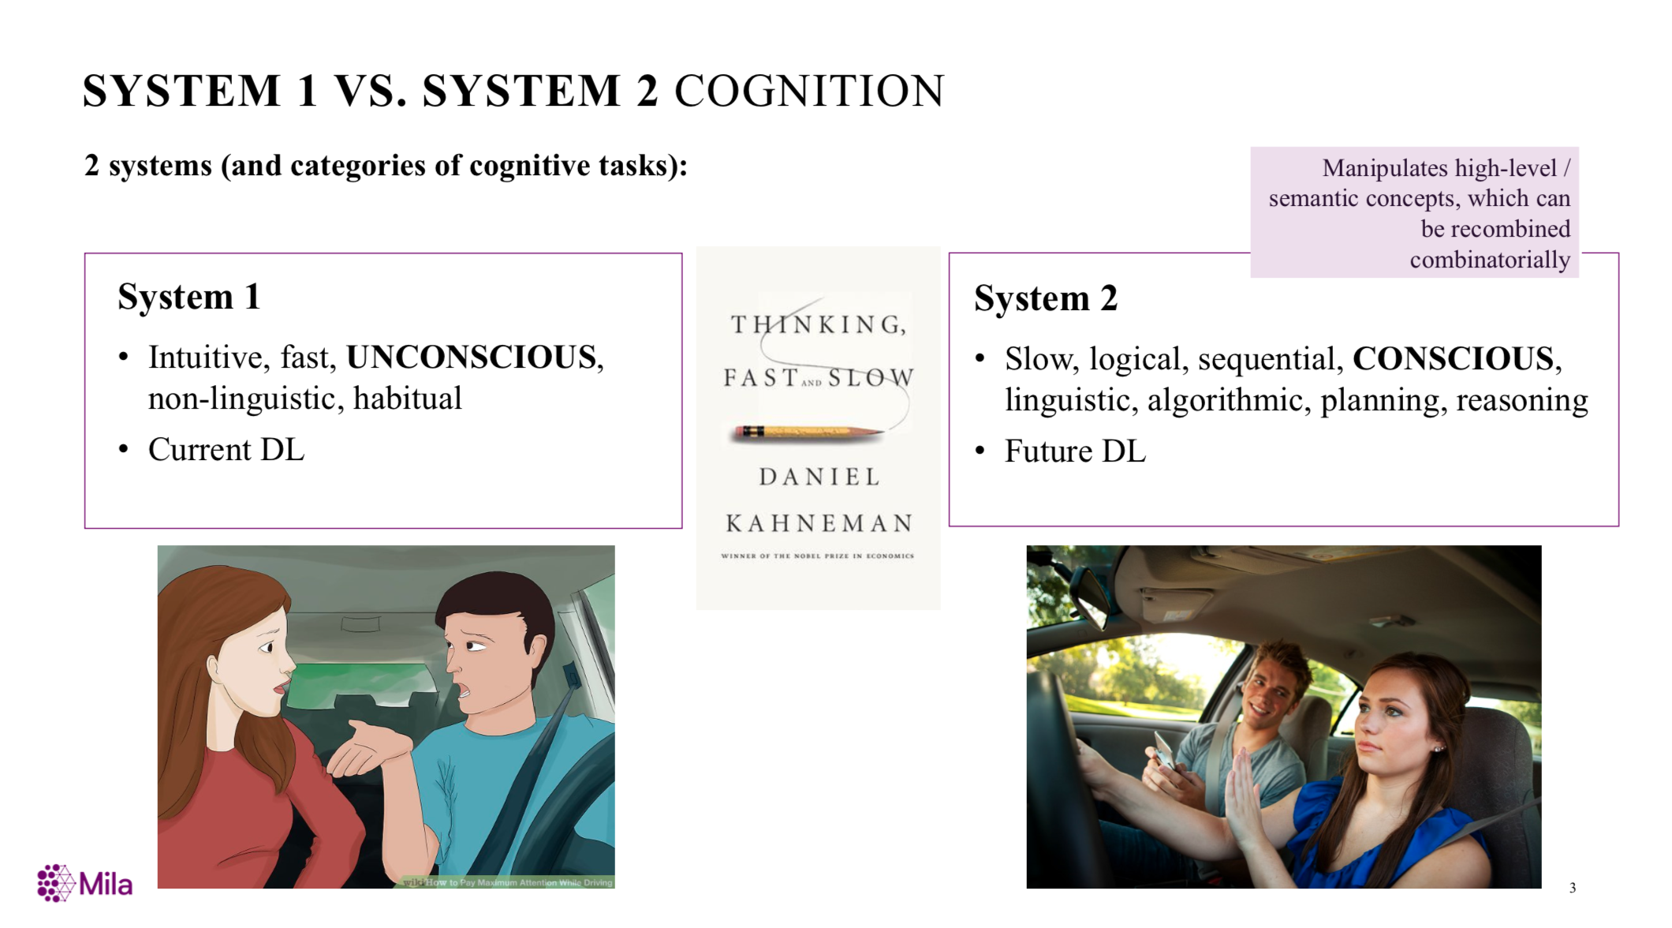
From Bengio’s NIPS’2019 Keynote

Slide 22
Reasoning w/ Cognitive Graph
System 1:
  Knowledge expansion by association in text when reading
System 2:
  Decision making w/ all the information
System 1
Intuitive
System 2
Analytic
Notes:
Dual process theory in cognition science says:

Slide 23

CogQA: Cognitive Graph for QA
An iterative framework corresponding to dual process theory
System 1
  extract entities to build the cognitive graph
  generate semantic vectors for each node
System 2
  Do reasoning based on semantic vectors and graph
  Feed clues to System 1 to extract next-hop entities
System 1
extract
Question
Cognitive Graph
input
Quality café
Los Angeles
…location featured in a number of Hollywood films, including Old School, Gone in 60 Seconds…
clues
Old school
Gone in 60 seconds
System 2
input
Todd Phillips
Dominic Sena
predict

Slide 24
Q1: How to represent a concept in a graph?

Slide 25
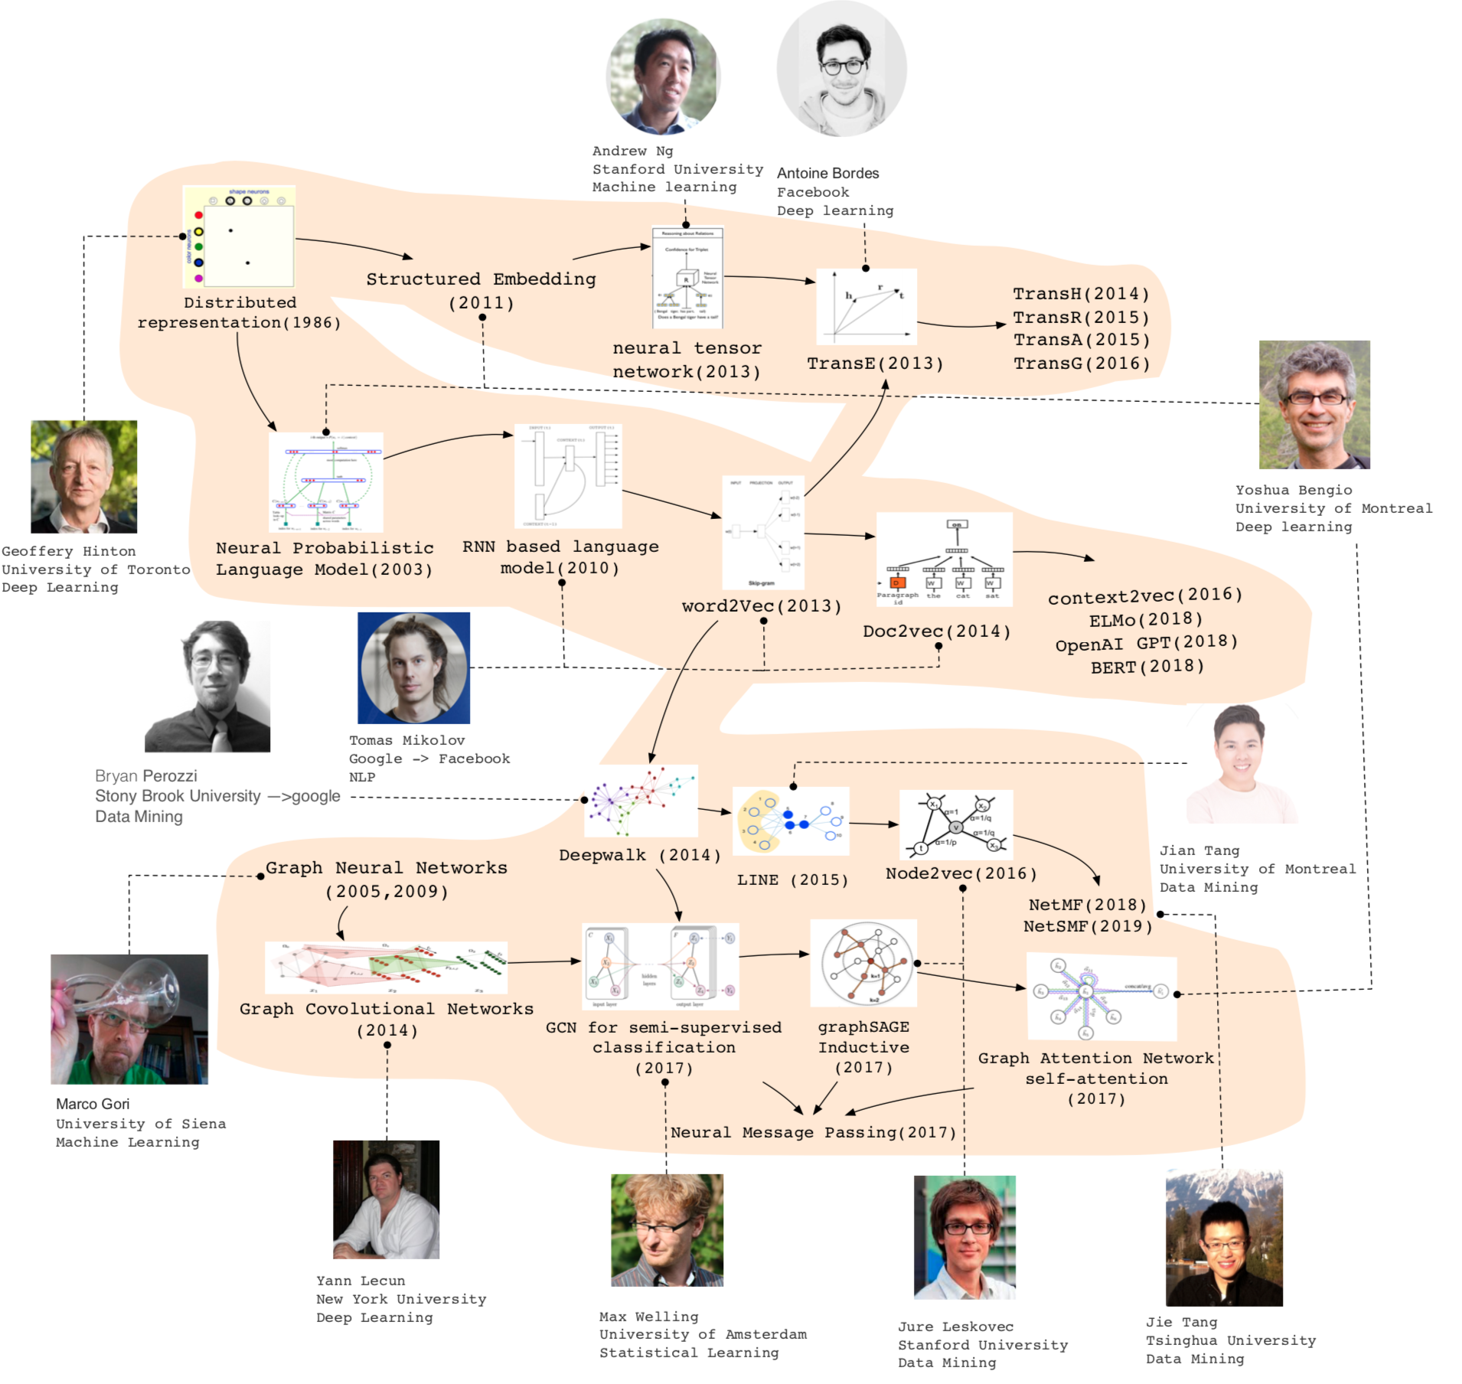

Slide 26
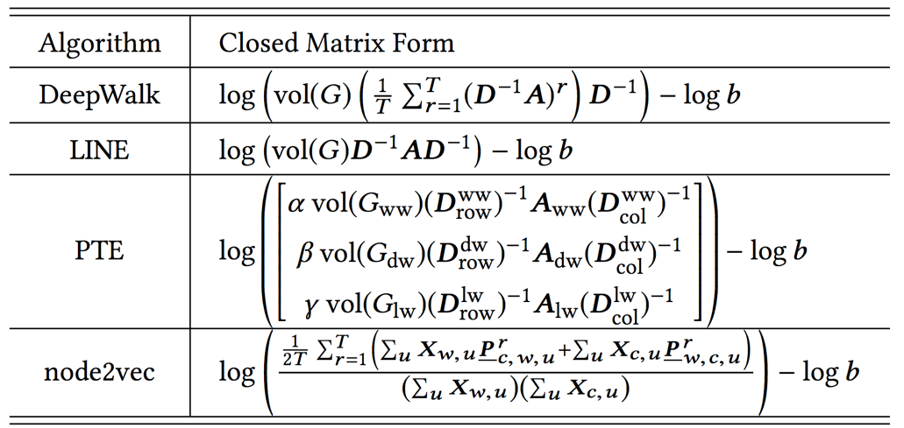
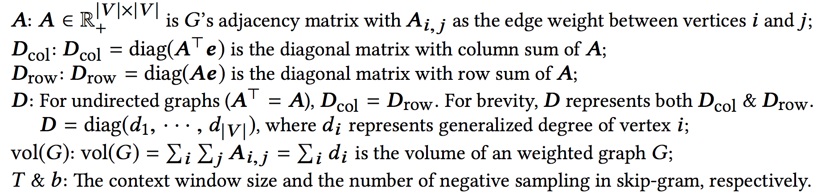
Unifying DeepWalk, LINE, PTE, and node2vec into Matrix Forms
Qiu et al. Network embedding as matrix factorization: unifying deepwalk, line, pte, and node2vec. WSDM’18. The most cited paper in WSDM’18 as of May 2019

Slide 27
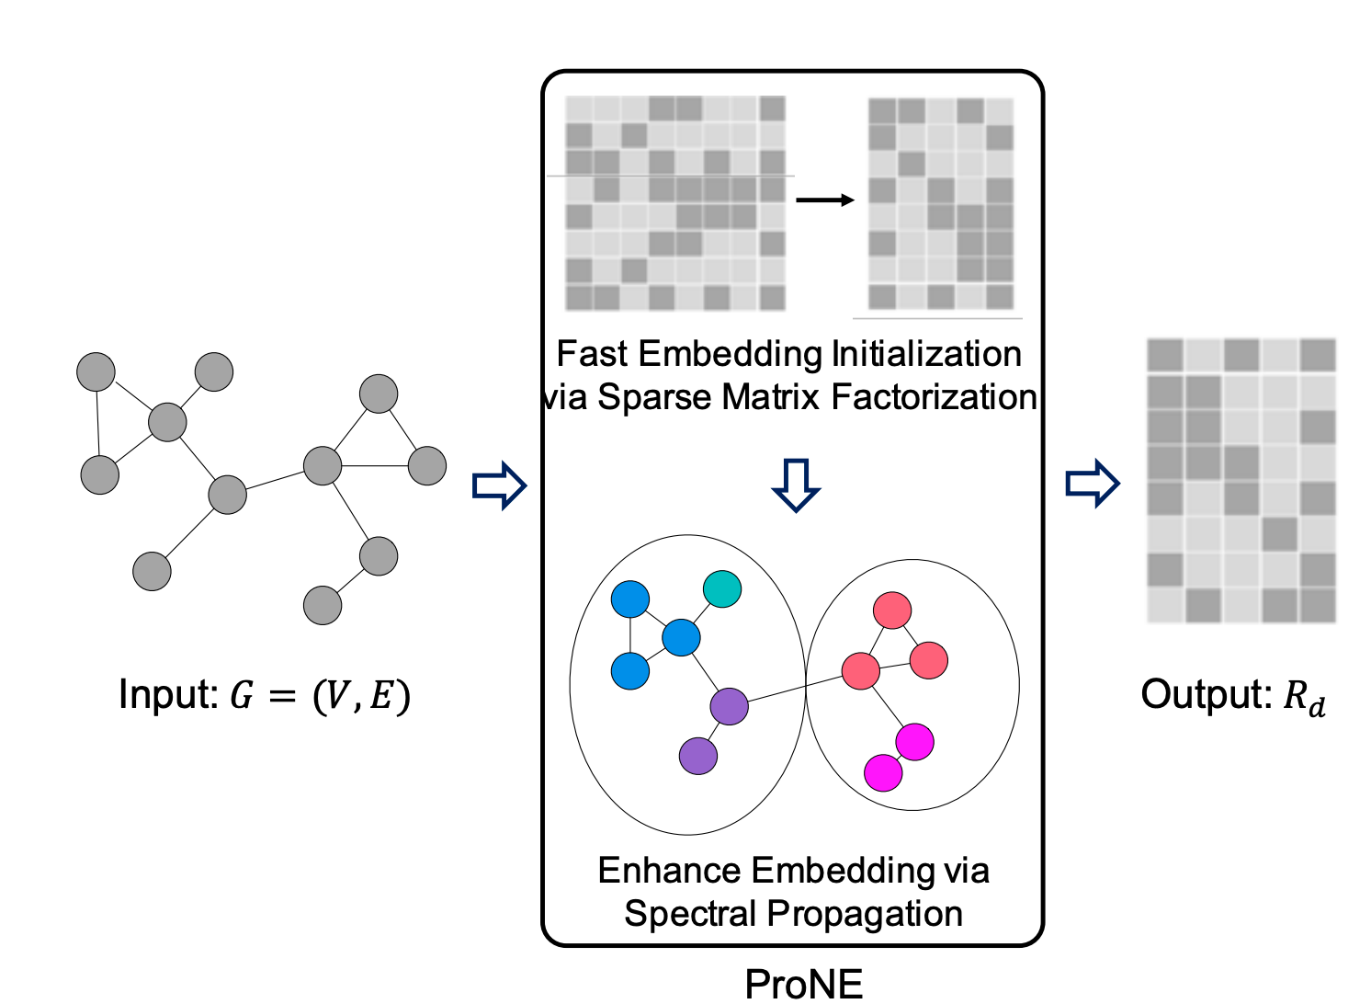
ProNE: Fast and Scalable Network Embedding
J. Zhang, Y. Dong, Y. Wang, J. Tang, and M. Ding. ProNE: Fast and Scalable Network Representation Learning. IJCAI’19.

Slide 28
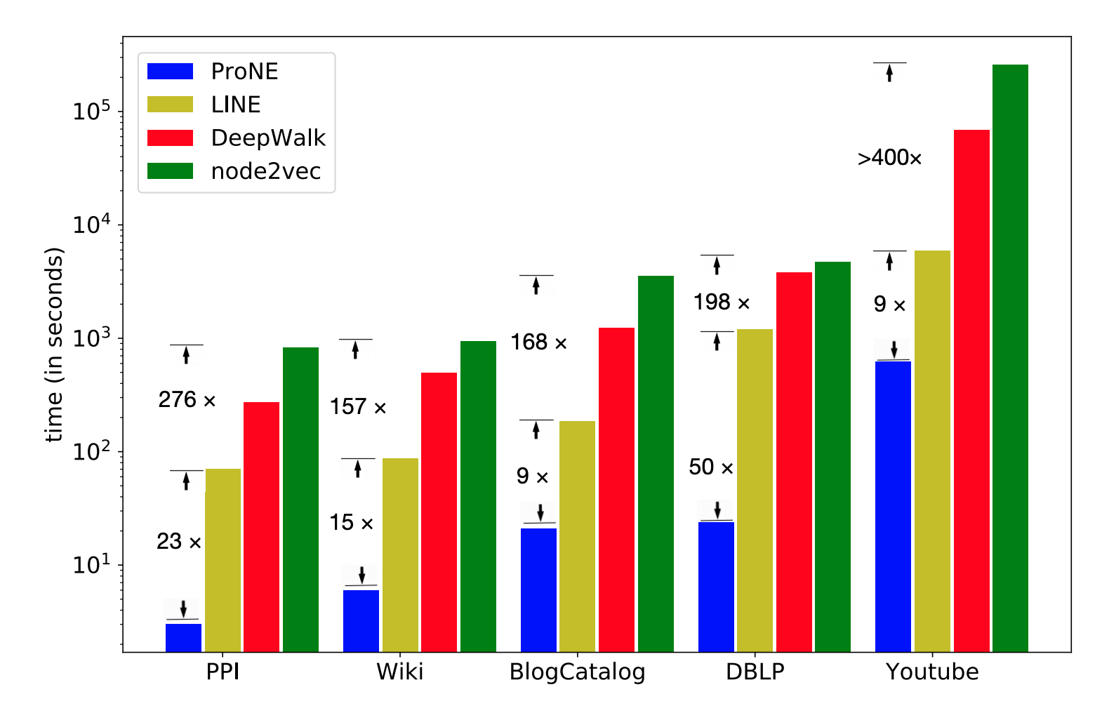
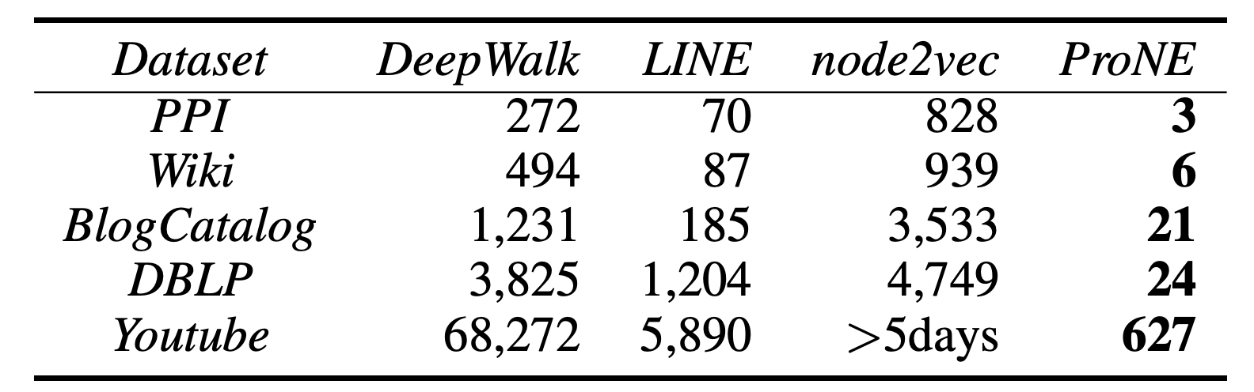
Results
* ProNE (1 thread) v.s.
Others (20 threads)
* 10 minutes on Youtube (~1M nodes)
** Code available at https://github.com/THUDM/ProNE

Slide 29
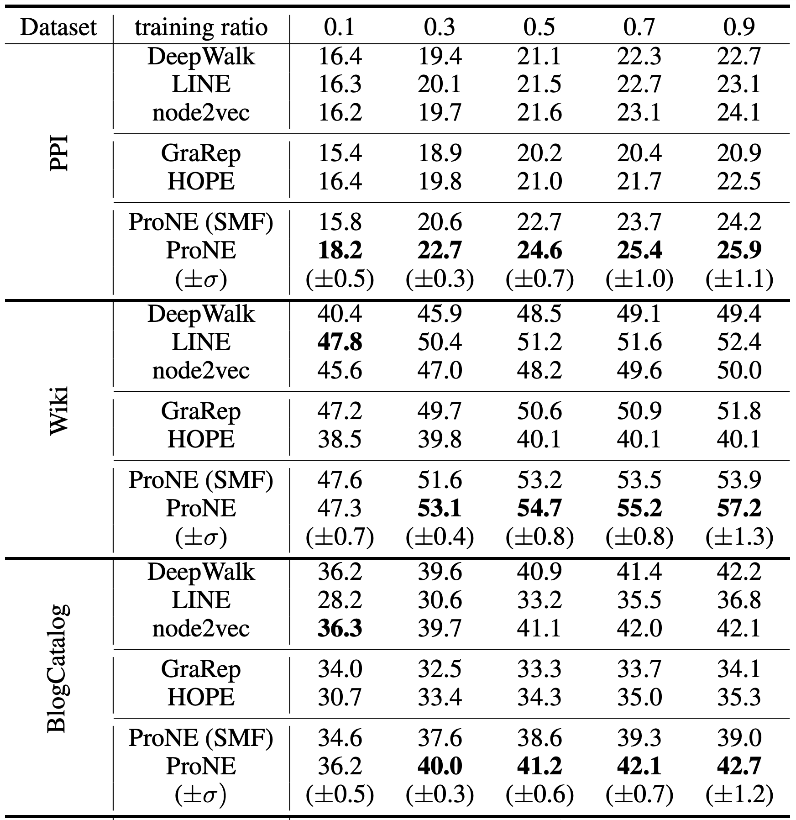
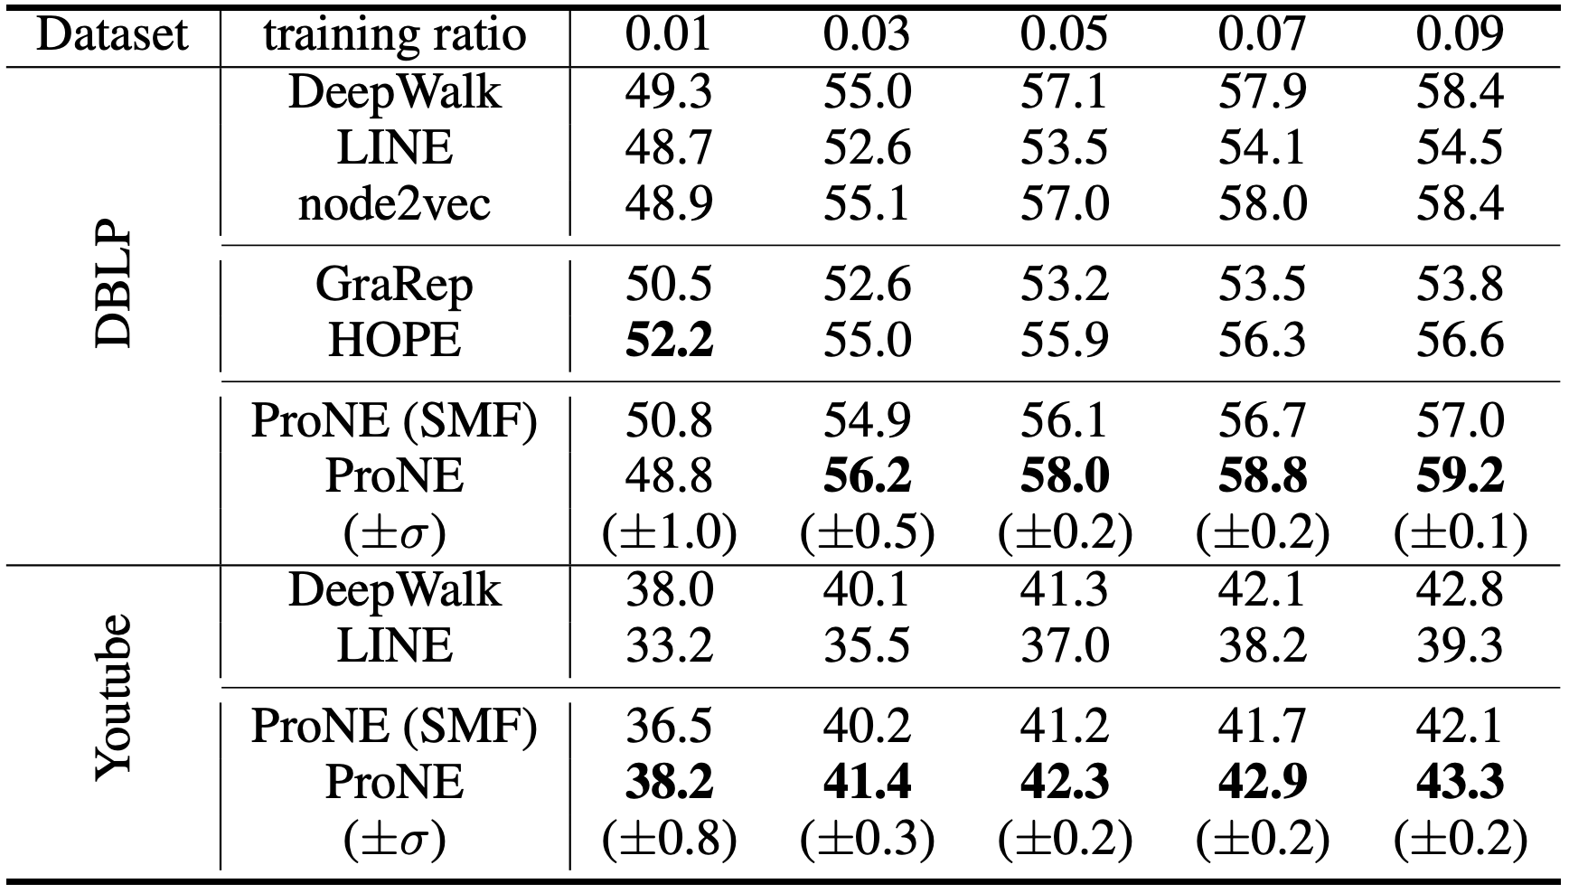
Effectiveness experiments
* ProNE (SMF) = ProNE w/ only sparse matrix factorization
Embed 100,000,000 nodes by one thread:
29 hours with performance superiority
** Code available at https://github.com/THUDM/ProNE
Notes:
We conduct multi-label classification experiments and use the Micro-f1 score in logistic regression to evaluate the performance of proposed method.
We named the interim embedding results generated by the sparse matrix factorization step in ProNE as ProNE(SMF).
Interestingly, ProNE is comparable to or sometimes even better than existing popular network embedding benchmarks.
With the spectral propagation technique further incorporated, ProNE generates the best performance among all baselines.
To sum up, our algorithm does not lose accuracy at high speeds and performs best on almost all datasets.

Slide 30
Recent Progress: BIDAF, BERT
reading comprehension: target at understanding the whole paragraph
BiDAF
BERT
XLNet
Rajpurkar, Pranav, et al. "SQuAD: 100,000+ Questions for Machine Comprehension of Text." EMNLP. 2016.

Slide 31
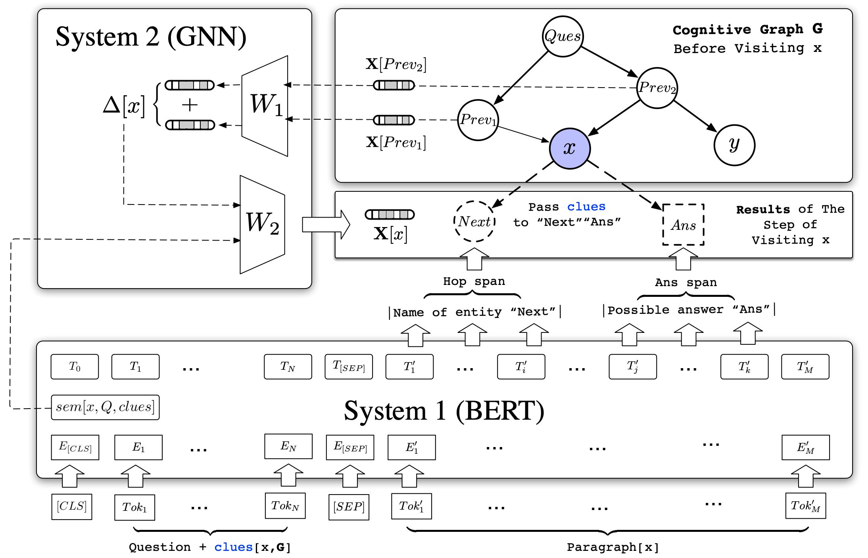
Cognitive Graph: DL + Dual Process Theory
?
System 2: explicit decision
System 1: implicit knowledge expansion
M. Ding, C. Zhou, Q. Chen, H. Yang, and J. Tang. Cognitive Graph for Multi-Hop Reading Comprehension at Scale. ACL’19.

Slide 32
Q2: How to make decision in the cognitive graph?

Slide 33
Cognitive Graph: Representation, Reasoning, and Decision
?
Notes:
Imagine a scenario where you have a wikipedia to look up for any entity, and how can you answer such a question?(click)
Question…
We will first search quality café and los angeless which seems useful for answering the question. Okay there are two quality café but we find CLUES in the middle one there are two films featured here. And then we read the paragraph in wiki about the two films and find out there directors.
Now, we construct a graph step by step, which includes all possible and userful information. And our brain will analyze the whole information and gives the final answer.
We name this graph “cognitive graph”.

Slide 34
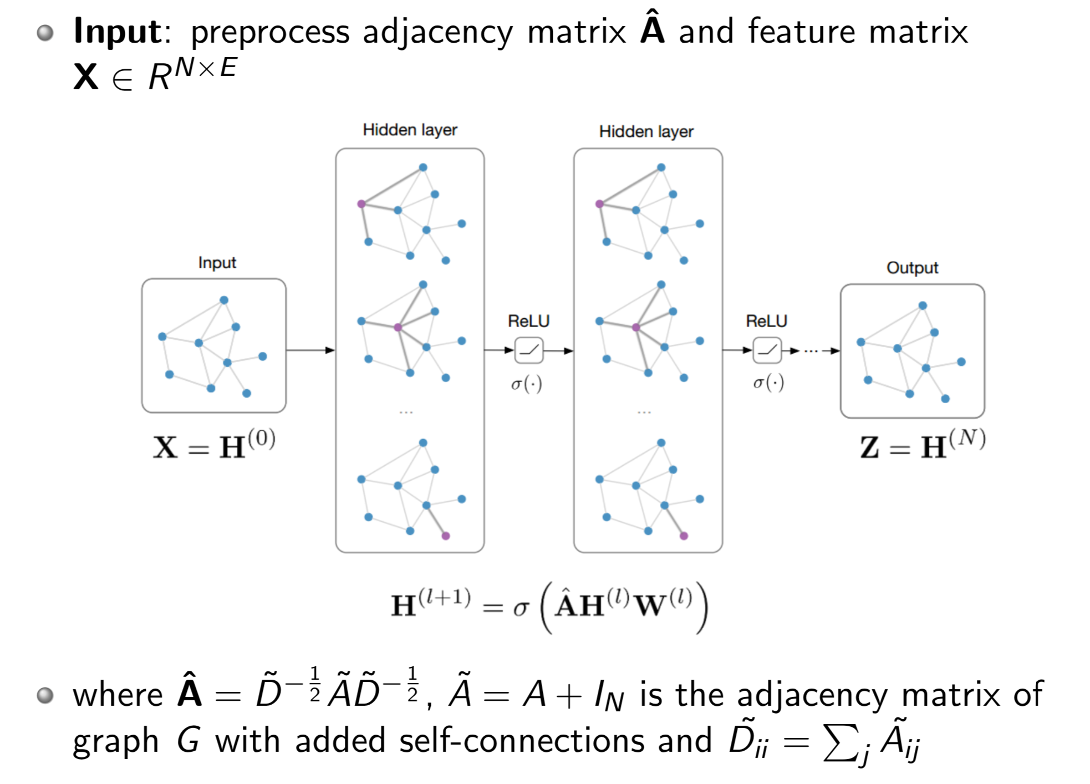
GNN/GCN Model Architecture

Slide 35

The Core of Graph Neural Networks
a
b
$$h_{v}=f(h_{a}, h_{b}, h_{c}, h_{d}, h_{e})$$
v
c
e
d
Neighborhood Aggregation:
  Aggregate neighbor information and pass into a neural network

Slide 36

Graph Neural Networks
a
b
$$h_{v}=f(h_{a}, h_{b}, h_{c}, h_{d}, h_{e})$$
v
c
e
d
$$∑WX$$
Neighborhood Aggregation:
  Aggregate neighbor information and pass into a neural network
  It can be viewed as a center-surround filter in CNN---graph convolutions!

Slide 37

GNN: Graph Convolutional Networks
a
b
$$h_{v}^{k}=σ(W_{k}\sum_{u∈N\left(v\right)∪v}{\frac{h_{u}^{k−1}}{\sqrt{|N(u)||N(v)|}}})$$
v
c
e
d
Kipf et al. Semi-supervised Classification with Graph Convolutional Networks. ICLR 2017

Slide 38



GNN: Graph Convolutional Networks
parameters in layer $k$
a
b
Non-linear activation function (e.g., ReLU)
$$h_{v}^{k}=σ(W_{k}\sum_{u∈N\left(v\right)∪v}{\frac{h_{u}^{k−1}}{\sqrt{|N(u)||N(v)|}}})$$
v
c
e
d
node $v$’s embedding at layer $k$
the neighbors of node $v$

Slide 39
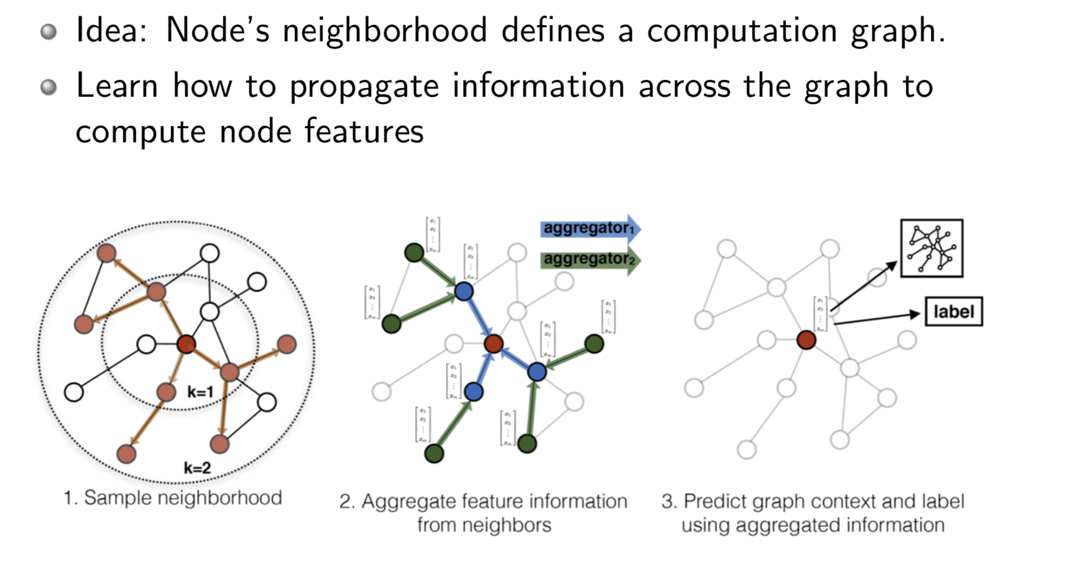
GraphSAGE Model Arthitecture
Hamilton et al. Inductive Representation Learning on Large Graphs. NIPS 2017

Slide 40

GraphSage
GCN
$$h_{v}^{k}=σ(W_{k}\sum_{u∈N\left(v\right)∪v}{\frac{h_{u}^{k−1}}{\sqrt{|N(u)||N(v)|}}})$$
a
b
v
c
e
GraphSage
Instead of summation, it concatenate neighbor & self embeddings
d
$$h_{v}^{k}=σ({[A}_{k}⋅AGG\left(\left\{h_{u}^{k−1}, ∀u∈N\left(v\right)\right\}\right), B_{k}h_{v}^{k−1}])$$
Generalized aggregation: any differentiable function that maps set of vectors to a single vector
Hamilton et al. Inductive Representation Learning on Large Graphs. NIPS 2017
Slide snipping from “Hamiltion & Tang, AAAI 2019 Tutorial on Graph Representation Learning”

Slide 41
Graph Attention Networks
a
b
v
Realistically, neighbors play different influences
c
e
d
Velickovic et al. Graph Attention Networks. ICLR 2018

Slide 42

Graph Attention Networks
GCN
$$h_{v}^{k}=σ(W_{k}\sum_{u∈N\left(v\right)∪v}{\frac{h_{u}^{k−1}}{\sqrt{|N(u)||N(v)|}}})$$
a
b
v
c
e
Graph Attention
d
$$h_{v}^{k}=σ(\sum_{u∈N\left(v\right)∪v}{α_{v,u}W^{k}h_{u}^{k−1}})$$
Learned attention weights
Velickovic et al. Graph Attention Networks. ICLR 2018

Slide 43
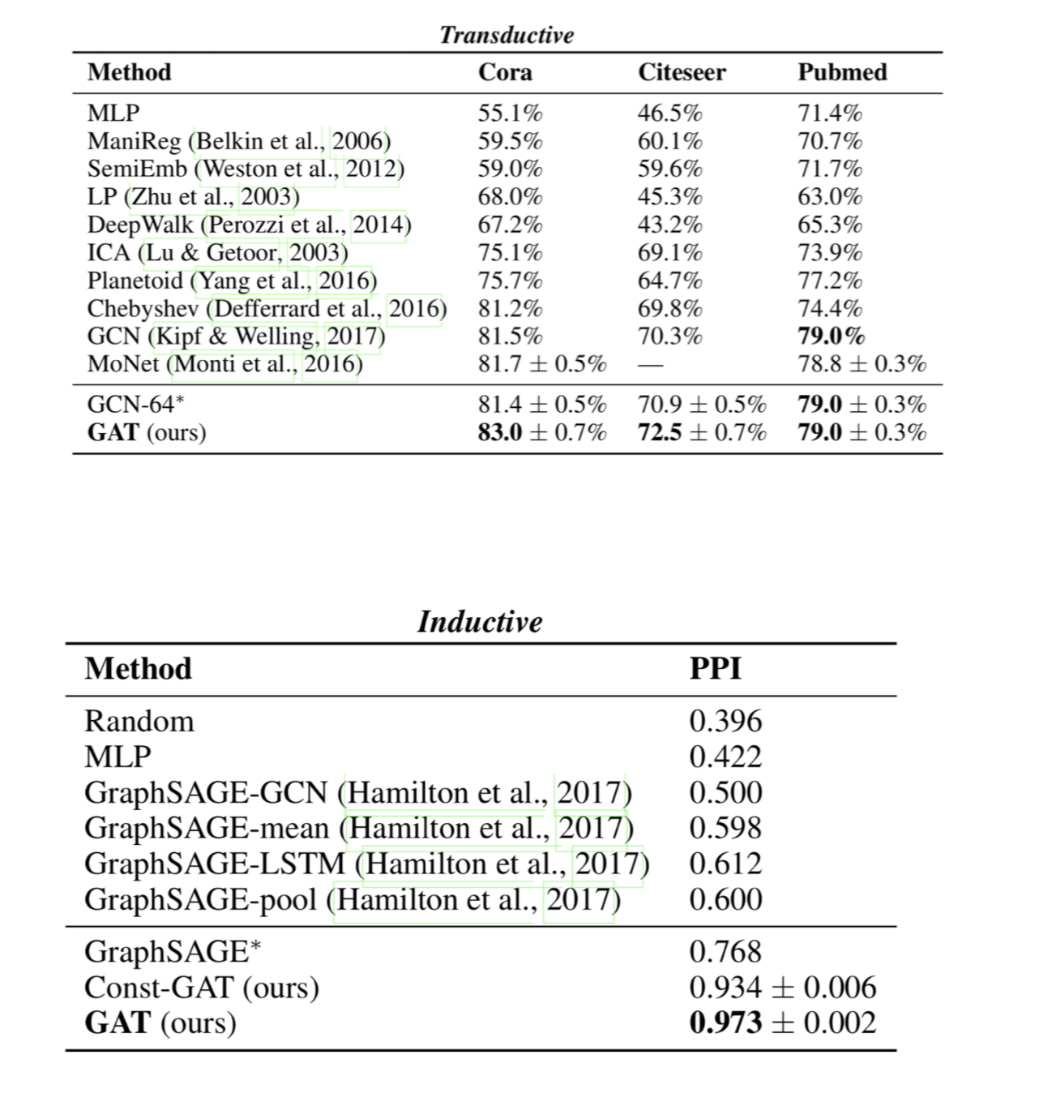
GAT Results

Slide 44
Cognitive Graph: DL + Dual Process Theory
System 2: explicit decision
System 1: implicit knowledge expansion
M. Ding, C. Zhou, Q. Chen, H. Yang, and J. Tang. Cognitive Graph for Multi-Hop Reading Comprehension at Scale. ACL’19.

Slide 45
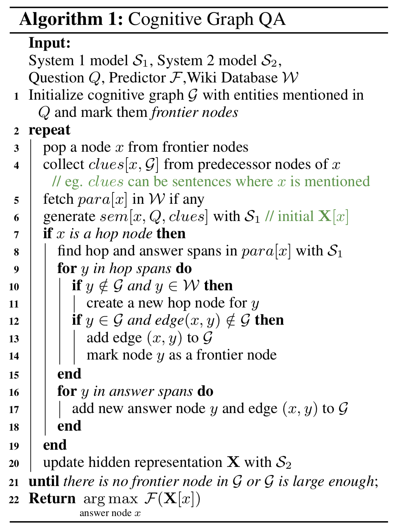
CogQA Algorithm and Training
Preprocess
  Mark the spans of next-hop entities and answer by fuzzy matching
  Golden cognitive graph and negative (hop and span) nodes
Train Task #1 (System 1)：
  Next-hop spans and answer spans extraction
Train Task #2 (System 1 & 2)：
  Prediction with GNN

Slide 46
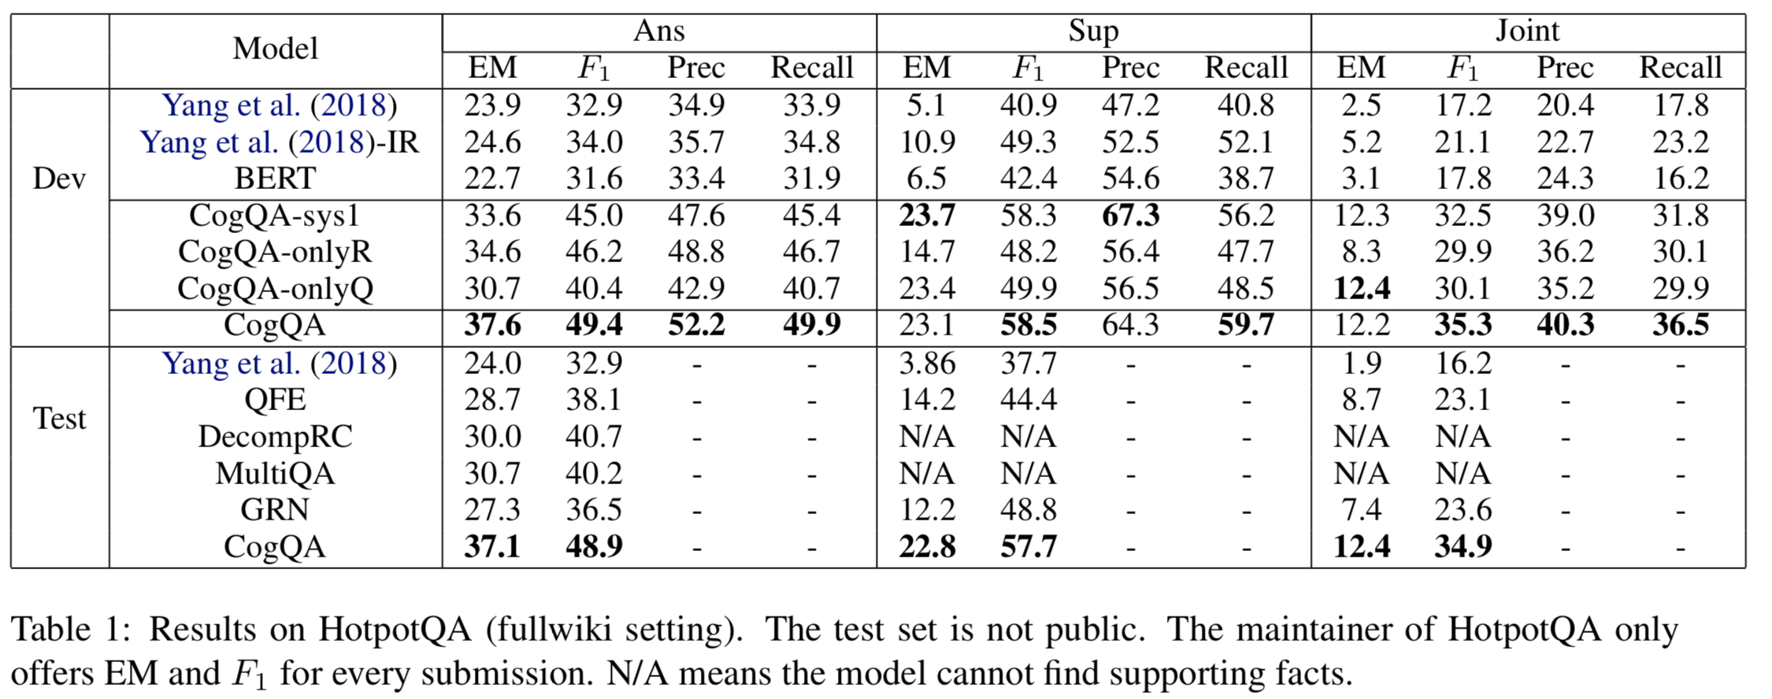
Performance
HotpotQA is a dataset with leaderboard similar to SQuAD
CogQA ranked 1st from 21, Feb to 15, May (nearly 3 month)
** Code available at https://github.com/THUDM/CogQA
Notes:
Two things to note:
Yang-IR: improved retrieval. We improve the retrieval process of Yang et al. for better comparison.
CogQA-onlyQ is designed that it only starts with the entities that appear in the question.
Free of elaborate retrieval methods, this setting can be regarded as a natural thinking pattern of human being, in which only explicit and reliable relations are needed in reasoning. CogQA-onlyQ still outperforms all the baselines

Slide 47
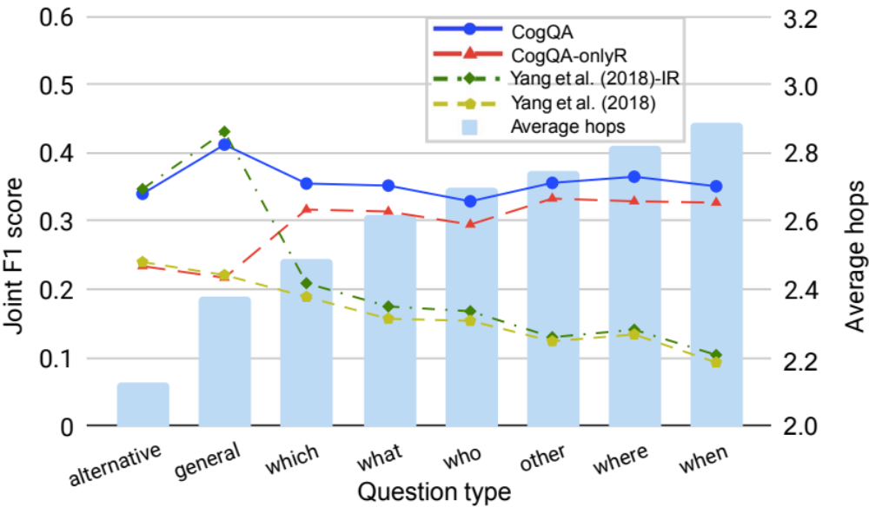
Reasoning Power
CogQA Performs much better on question with more hops！
Notes:
CogQA Performs much better on question with more hops

Slide 48
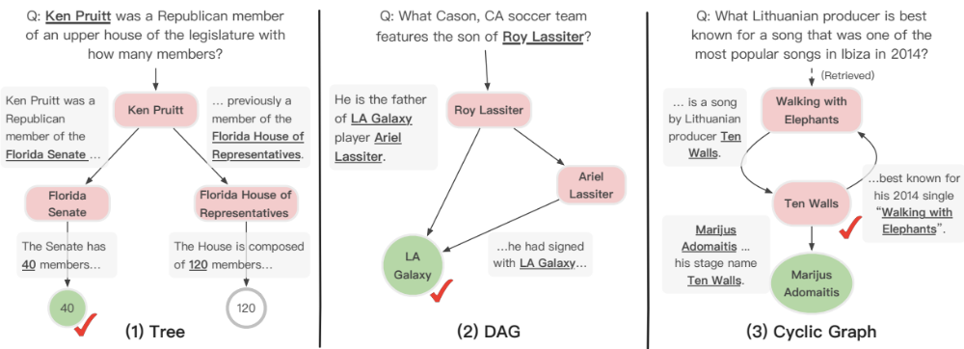
Case Study
Tree-shape Cognitive Graph
Users can verify the answer by comparing it with another possible reasoning chain.
“Upper House” in the question is similar to “Senate” not “House of Representative”
Notes:
We show how the cognitive graph clearly explains complex reasoning processes in our experiments.
The cognitive graph highlights the heart of the question in case (1) – i.e., to choose between the number of members in two houses. CogQA makes the right choice based on semantic similarity between “Senate” and “upper house”.
Case (2) illustrates that the robustness of answering can be boosted by exploring parallel reasoning paths.
In Case (3) our model finally gets the answer “Marijus Adomaitis” while the annotated ground truth is “Ten Walls”. However, when backtracking the reasoning process in cognitive graph, we find that the model has already reached “Ten Walls” and answers with his real name, which is acceptable and even more accurate. This is why we need explainability.

Slide 49
Case Study
DAG-shape Cognitive Graph
Multiple supporting facts provides richer information, increasing the credibility of the answer.

Slide 50
Case Study
CogQA gives the answer “Marijus Adomaitis” while the ground truth is “Ten Walls”.
By examining, Ten Walls is just the stage name of Marijus Adomaitis!
Without cognitive graphs, black-box models cannot achieve it.

Slide 51
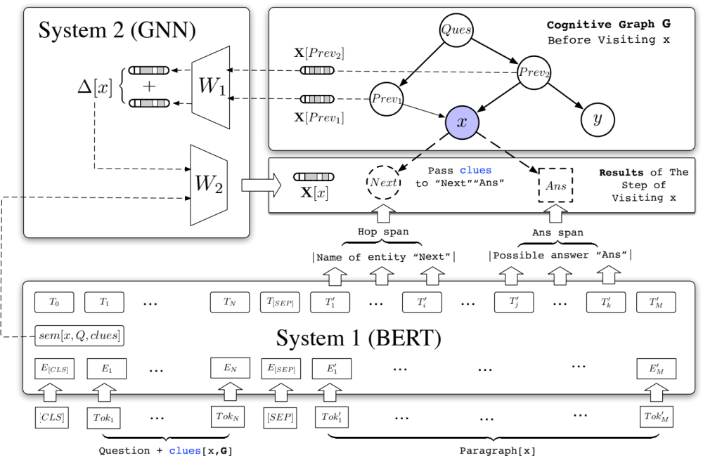
Summary
Iterative Framework --> Myopic Retrieval
Cognitive Graph --> Explainability
Dual process theory --> System 2 Reasoning
Cognitive graph
CogQA framework

Slide 52
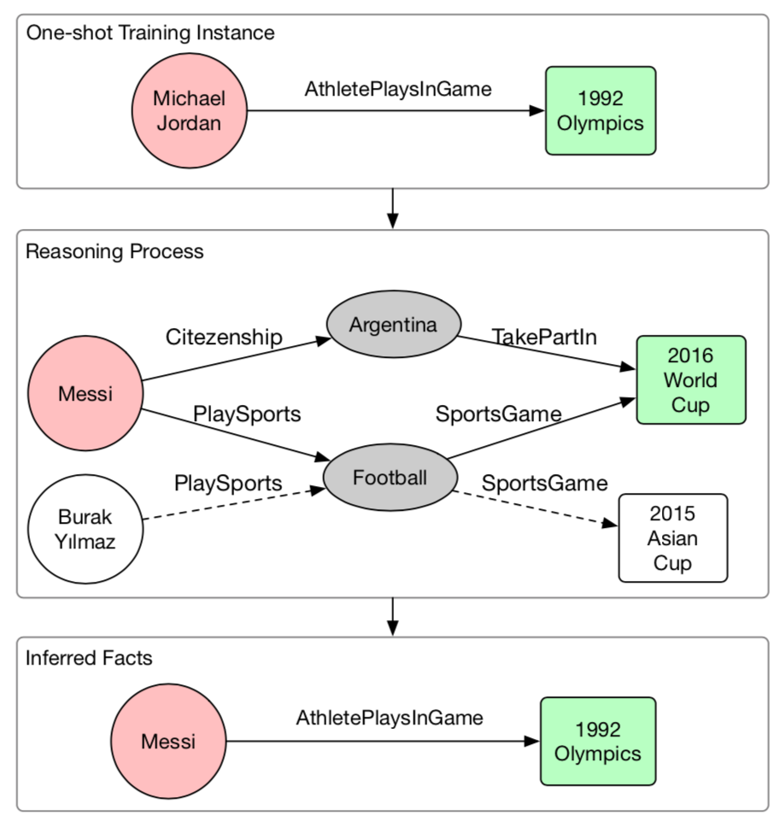

More Applications: KG completion
Completing knowledge graph with cognitive graph

Slide 53
Cognitive Graph
—Trillion-scale common-sense knowledge graph
Edward Feigenbaum
Turing Award Winner
Tim Berners Lee
Turing Award Winner
Big Data
Knowledge
Intelligence
* AI = Knowledge + Intelligence
J. Tang, J. Zhang, L. Yao, J. Li, L. Zhang, and Z. Su. ArnetMiner: Extraction and Mining of Academic Social Networks. KDD’08. pp.990-998.
Notes:
Knowledge graph was used by Google in 2012
Knowledge engineering, expert system
CYC: the world's longest-lived AI project (1985)

Slide 54

Cognitive Graph Toolkit

Slide 55

CogDL
—A Toolkit for ​Deep Learning on Graphs
** Code available at https://keg.cs.tsinghua.edu.cn/cogdl/

Slide 56

CogDL
—A Toolkit for ​Deep Learning on Graphs
Notes:
CogDL is a graph representation learning toolkit that allows researchers and developers to train baseline or custom models for node classification, link prediction and other tasks on graphs. It provides implementations of several models, including: non-GNN Baselines like Deepwalk, LINE, NetMF, GNN Baselines like GCN, GAT, Graphsage.

Slide 57


Cognitive Graph Enabled API
示例应用：趋势预测
平均误差率（MAE)：
趋势预测0.158
新技术指数小于0.26
实时数据
采集系统
面向知识计算与认知推理的智能服务
知识获取
Read Web
表示
推理
预测
决策
智能总线
知识表示
认知推理
新知识学习
专家智库
Read Media
图表示
自校验
趋势预测
智能问答
大数据分布式数据存储、管理和计算平台

Slide 58
Related Publications
Ming Ding, Chang Zhou, Qibin Chen, Hongxia Yang, and Jie Tang. Cognitive Graph for Multi-Hop Reading Comprehension at Scale. ACL’19.
Jie Zhang, Yuxiao Dong, Yan Wang, Jie Tang, and Ming Ding. ProNE: Fast and Scalable Network Representation Learning. IJCAI’19.
Yukuo Cen, Xu Zou, Jianwei Zhang, Hongxia Yang, Jingren Zhou and Jie Tang. Representation Learning for Attributed Multiplex Heterogeneous Network. KDD’19.
Fanjin Zhang, Xiao Liu, Jie Tang, Yuxiao Dong, Peiran Yao, Jie Zhang, Xiaotao Gu, Yan Wang, Bin Shao, Rui Li, and Kuansan Wang. OAG: Toward Linking Large-scale Heterogeneous Entity Graphs. KDD’19.
Qibin Chen, Junyang Lin, Yichang Zhang, Hongxia Yang, Jingren Zhou and Jie Tang. Towards Knowledge-Based Personalized Product Description Generation in E-commerce. KDD'19.
Yifeng Zhao, Xiangwei Wang, Hongxia Yang, Le Song, and Jie Tang. Large Scale Evolving Graphs with Burst Detection. IJCAI’19.
Yu Han, Jie Tang, and Qian Chen. Network Embedding under Partial Monitoring for Evolving Networks. IJCAI’19.
Yifeng Zhao, Xiangwei Wang, Hongxia Yang, Le Song, and Jie Tang. Large Scale Evolving Graphs with Burst Detection. IJCAI’19.
Jiezhong Qiu, Yuxiao Dong, Hao Ma, Jian Li, Chi Wang, Kuansan Wang, and Jie Tang. NetSMF: Large-Scale Network Embedding as Sparse Matrix Factorization. WWW'19.
Jiezhong Qiu, Jian Tang, Hao Ma, Yuxiao Dong, Kuansan Wang, and Jie Tang. DeepInf: Modeling Influence Locality in Large Social Networks. KDD’18.
Jiezhong Qiu, Yuxiao Dong, Hao Ma, Jian Li, Kuansan Wang, and Jie Tang. Network Embedding as Matrix Factorization: Unifying DeepWalk, LINE, PTE, and node2vec. WSDM’18.
Jie Tang, Jing Zhang, Limin Yao, Juanzi Li, Li Zhang, and Zhong Su. ArnetMiner: Extraction and Mining of Academic Social Networks. KDD’08.
  For more, please check here http://keg.cs.tsinghua.edu.cn/jietang

Slide 59
Thank you！
Collaborators:
Jie Zhang, Ming Ding, Jiezhong Qiu, Qibin Chen, Yifeng Zhao, Yukuo Cen, Yu Han, Fanjin Zhang, Xu Zou, Yan Wang, et al. (THU)
Hongxiao Yang, Chang Zhou, Le Song, Jingren Zhou, et al. (Alibaba)
Yuxiao Dong, Chi Wang, Hao Ma, Kuansan Wang (Microsoft)
  Jie Tang, KEG, Tsinghua U http://keg.cs.tsinghua.edu.cn/jietang
  Download all data & Codes https://keg.cs.tsinghua.edu.cn/cogdl/
  https://github.com/THUDM

Slide 60

IEEE Transactions on Big Data
Impact Factor

Slide 61


Slide 62








SCI
2.731
IMPACT
FACTOR
Information Sciences
+ High-quality peer-review
+ CAP (Continuous Article Publishing): Faster publishing, faster indexed
+ Article categories: Review, Research paper, MOOP, Perspective, Letter, etc.
+ Indexed by SCI, EI, INSPEC, SCOPUS, etc.
Editor-in-Chief
Hong MEI
AEIC in Computer Science
Zhi-Hua ZHOU
Connecting Chinese minds to the world
> > > scis.scichina.com > > >
Professional Peer-review
Efficient Publishing
Finding reviewers from all over the world using data-mining system
Continuous article publishing (CAP): Faster publishing, faster indexed
Cutting-edge Research Topics
Various Article Types

Slide 63

ai open Journal
for open and sharing

Slide 64
认知图谱 (Cognitive Graph)
—知识图谱, 认知推理, 逻辑生成
  The slides can be downloaded at http://keg.cs.tsinghua.edu.cn/jietang

